Slide 2
Written, Directed & Edited by
Sibin Babu and Riley Arndt

Slide 3
PRODUCTION OBJECTIVE
The main objective for this production was to network and communicate with a international brand in order to deliver a professional television commercial that may spark their interest in working with us on future projects.

Slide 4
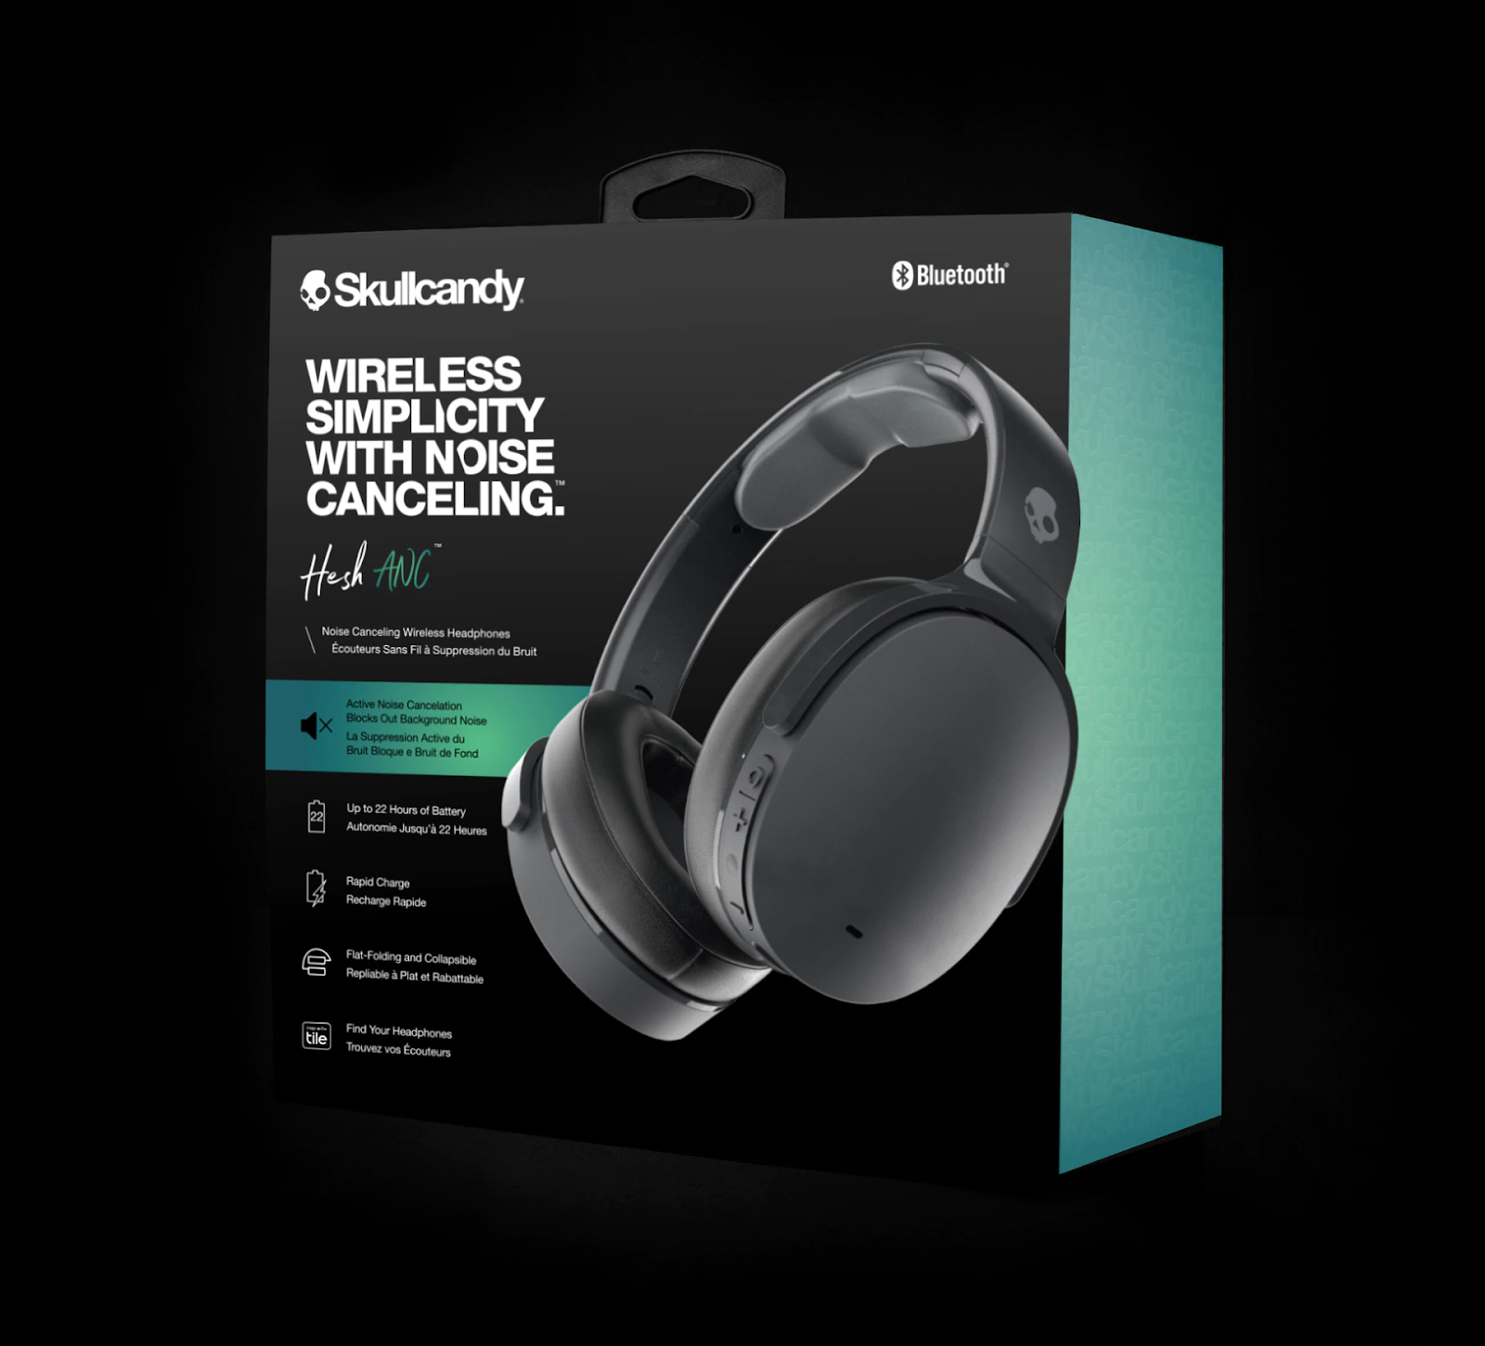
PRODUCTION CONCEPT
The concept was simple yet creatively challenging for this project.
Introduced to Skullcandy's Byron Bay branch manager; Justin.
Skullcandy are in the process of transitioning their marketing campaign from action sports towards creative artists.
An action sports athlete displaying the endless limits of the headphones only to be revealed that he is working on a film set where the creative leading director is also using the Skullcandy headphones.

Slide 5
PRE-PRODUCTION

Slide 6
Treatment
Script
45 SECONDS
ACT 1
Chris, a young male boxing athlete is sitting slumped over in a dirty old locker room. The over bearing sound of crowds cheering, commentators and news reporters building the anticipation of his debut fight creeps over him. His breathes grow heavier as the atmospheric noise introduces fists pounding against a boxing bag. Chris reaches down into his duffle bag and pulls out a pair of SkullCandy Headphones. He slowly puts them over his ears. The overbearing atmospheric noise fades away to silence. Chris closes his eyes and takes a deep breath. Chris then abruptly opens his eyes and jumps out of his seat.
ACT 2
Chris then aggressively flips a truck tyre, does push ups, throws weighted ropes and punches a hanging boxing bag. He is then running at an intense pace in an empty stadium. Then again in front of a metal fence. Then again in front of a line of trees. As his running comes to a slow halt his heavy breathes begin to slow down.
ACT 3
Suddenly, from a distance a strong female voice; Elizabeth, yells:
Elizabeth
“annnd cut!”.
It is revealed Chris is in a movie studio. After a moment Elizabeth says:
Elizabeth
“That was perfect, I can feel it!”.
Elizabeth takes her SkullCandy headphones off of her head and places it on a headphone stand in front of her. Cut to black as logo animation begins.
15 SECONDS
ACT 1
Chris, a young male boxing athlete is sitting slumped over breathing heavy in a dirty old locker room. The over bearing sound of crowds cheering, fists pounding against boxing bags, and commentators and news reporters building the anticipation of his debut fight creeps over him. Chris reaches down into his duffle bag and pulls out a pair of SkullCandy Headphones. He puts them over his ears. The overbearing atmospheric noise fades away to silence. Chris then abruptly jumps out of his seat.
ACT 2
Chris then aggressively punches a hanging boxing bag. He is then running at an intense pace in an empty stadium. As his running comes to a slow halt his heavy breathes begin to slow down.
ACT 3
Suddenly, from a distance a strong female voice; Elizabeth, yells:
Elizabeth
“annnd cut!”.
It is revealed Chris is in a movie studio. After a moment Elizabeth says:
Elizabeth
“That was perfect, I can feel it!”.
Elizabeth takes her SkullCandy headphones off of her head and places it on a headphone stand in front of her. Cut to black as logo animation begins.
45 SECONDS
FADE IN:
INT. LOCKER ROOM - NIGHT
Chris, a young male boxing athlete is sitting slumped over in a dirty old locker room. The over bearing sound of crowds cheering, commentators and news reporters building the anticipation of his debut fight creeps over him. His breathes grow heavier as the atmospheric noise introduces fists pounding against a boxing bag. Chris reaches down into his duffle bag and pulls out a pair of SkullCandy Headphones. He slowly puts them over his ears. The overbearing atmospheric noise fades away to silence. Chris closes his eyes and takes a deep breath. Chris then abruptly opens his eyes and jumps out of his seat.
INT. WAREHOUSE - NIGHT
Chris then aggressively flips a truck tyre, does push ups, throws weighted ropes and punches a hanging boxing bag.
EXT. PARK - NIGHT
He is then running at an intense pace in an empty stadium. Then again in front of a metal fence. Then again in front of a line of trees. As his running comes to a slow halt his heavy breathes begin to slow down.
INT. GREEN SCREEN - NIGHT
Suddenly, from a distance a strong female voice enters.
ANNND CUT!
It is revealed Chris is in a movie studio. A moment pass as the organised chaos of the film set continues.
ELIZABETH (CONT'D)
That was perfect, I can feel it!
Elizabeth takes her SkullCandy headphones off of her head and places it on a headphone stand in front of her.
Cut to black as logo animation begins.
15 SECONDS
FADE IN:
INT. LOCKER ROOM - NIGHT
Chris, a young male boxing athlete is sitting slumped over breathing heavy in a dirty old locker room. The over bearing sound of crowds cheering, fists pounding against boxing bags, and commentators and news reporters building the anticipation of his debut fight creeps over him. Chris reaches down into his duffle bag and pulls out a pair of SkullCandy Headphones. He puts them over his ears. The overbearing atmospheric noise fades away to silence. Chris then abruptly jumps out of his seat.
INT. WAREHOUSE - NIGHT
Chris then aggressively punches a hanging boxing bag.
EXT. PARK - NIGHT
He is then running at an intense pace in an empty stadium. As his running comes to a slow halt his heavy breathes begin to slow down.
INT. GREEN SCREEN STUDIO - NIGHT
Suddenly, from a distance a strong female voice enters.
ANNND CUT!
It is revealed Chris is in a movie studio. A moment passes as the organised chaos of the film set continues.
I can feel it!
Elizabeth takes her SkullCandy headphones off of her head and places it on a headphone stand in front of her.
Cut to black as logo animation begins.

Slide 7
Shot List
AV Script
45 SECONDS
Sc 1. Interior Locker Room Night.
Shot 1: MCU Chris centre framed follow right through. Push in to ECU as Chris exits.
Sc 2. Interior Green Screen Studio Night.
Shot 1: Start on ECU, pull out to MCU tracking tyre flip right through.
Shot 2: MCU follow Chris doing four push ups in the same motion as the tyre.
Shot 3: Wide shot Chris throwing the battle ropes.
Shot 4: Wide Chris punching a hanging boxing bag right through.
Shot 5: MCU following Chris punching boxing bag.
Sc 3. Exterior Cavanbah Centre Park Night.
Shot 1: Wide Chris running in front of the chain link fence.
Shot 2: Wide Chris running in front of a line of trees.
Shot 3: Wide Chris running in front of rows of empty seats.
Shot 4: Wide to ECU close in on Chris right through.
Sc 4. Green Screen Studio Night.
Shot 1: ECU to MCU Chris breathing heavily.
Shot 2 MCU pull out to Wide.
Shot 3: Wide panorama 180 degrees to reveal film set.
Shot 4: Start Wide to push in to MCU close in on director and headphones.
15 SECONDS
Sc 1. Interior Locker Room Night.
Shot 1: MCU Chris centre framed right through.
Shot 2: MCU tracking Chris as he picks up the headphones.
Shot 3: MCU to ECU as Chris stands out of his seat.
Sc 2. Interior Warehouse Night.
Shot 1: MCU tracking Chris punching boxing bag.
Sc 3. Exterior Park Night.
Shot 1: MCU tracking Chris’ legs in the same motion as the tracked punch.
Shot 2: Wide Chris running in a local stadium in front of rows of empty seats.
Shot 3: Wide to ECU close in on Chris right through.
Sc 4. Green Screen Studio Night.
Shot 1: ECU to MCU Chris breathing heavily.
Shot 2: MCU to Wide dolly movement.
Shot 3: Wide panorama 180 degrees to reveal film set.
Shot 4: Wide to MCU close in on director and headphones.
VIDEO | AUDIO | LOCATION
Chris; a young male boxing athlete is sitting slumped over. | Crowds cheering, commentators and news reporters speaking excitedly. Fluorescent light flicker foley. | Mullumbimby Bowling Club Locker Room.
Chris reaches down into his duffle bag and pulls out a pair of SkullCandy Headphones. He slowly puts them on. | The sound of the crowd dissipates before it is silent. | Mullumbimby Locker Room.
Chris then abruptly opens his eyes and jumps out of his seat. | SkullCandy soundtrack. | Mullumbimby Bowling Club Locker Room.
Chris is vigorously flipping a truck tyre. | Sound of tyre flipping. SkullCandy soundtrack. | Warehouse (Back of Green Screen Studio)
Chris doing push ups. | Heavy breathing foley. SkullCandy soundtrack. | Warehouse (Back of Green Screen Studio)
Chris is throwing battle ropes. | Ropes smacking the concrete foley. SkullCandy soundtrack. | Warehouse (Back of Green Screen Studio)
Chris is punching a hanging boxing bag | Fists pounding against the boxing bag foley. Heavy breathing foley. SkullCandy soundtrack. | Warehouse (Back of Green Screen Studio)
He is running at an intense pace in an empty stadium. | Feet hitting the grass foley. Night time ambience. SkullCandy soundtrack. | Robina Rugby Stadium
He is running in front of a metal fence. | Feet hitting the concrete foley. Night time ambience. SkullCandy soundtrack. | Robina Rugby Stadium
He is running in front of a line of trees and comes to a halt. | Feet hitting the grass foley. Night time ambience. SkullCandy soundtrack. | Robina Rugby Stadium
Running comes to a halt. | Foley from the stadium. SkullCandy soundtrack. | Green Screen Studio
Pull out to reveal Chris in TV Studio with SkullCandy Headphones on. | Busy film set foley and ambience. | Green Screen Studio
Logo Animation | Fluorescent light flicker sound. | Logo over black

Slide 8
PREVIZ NO.1

Slide 9
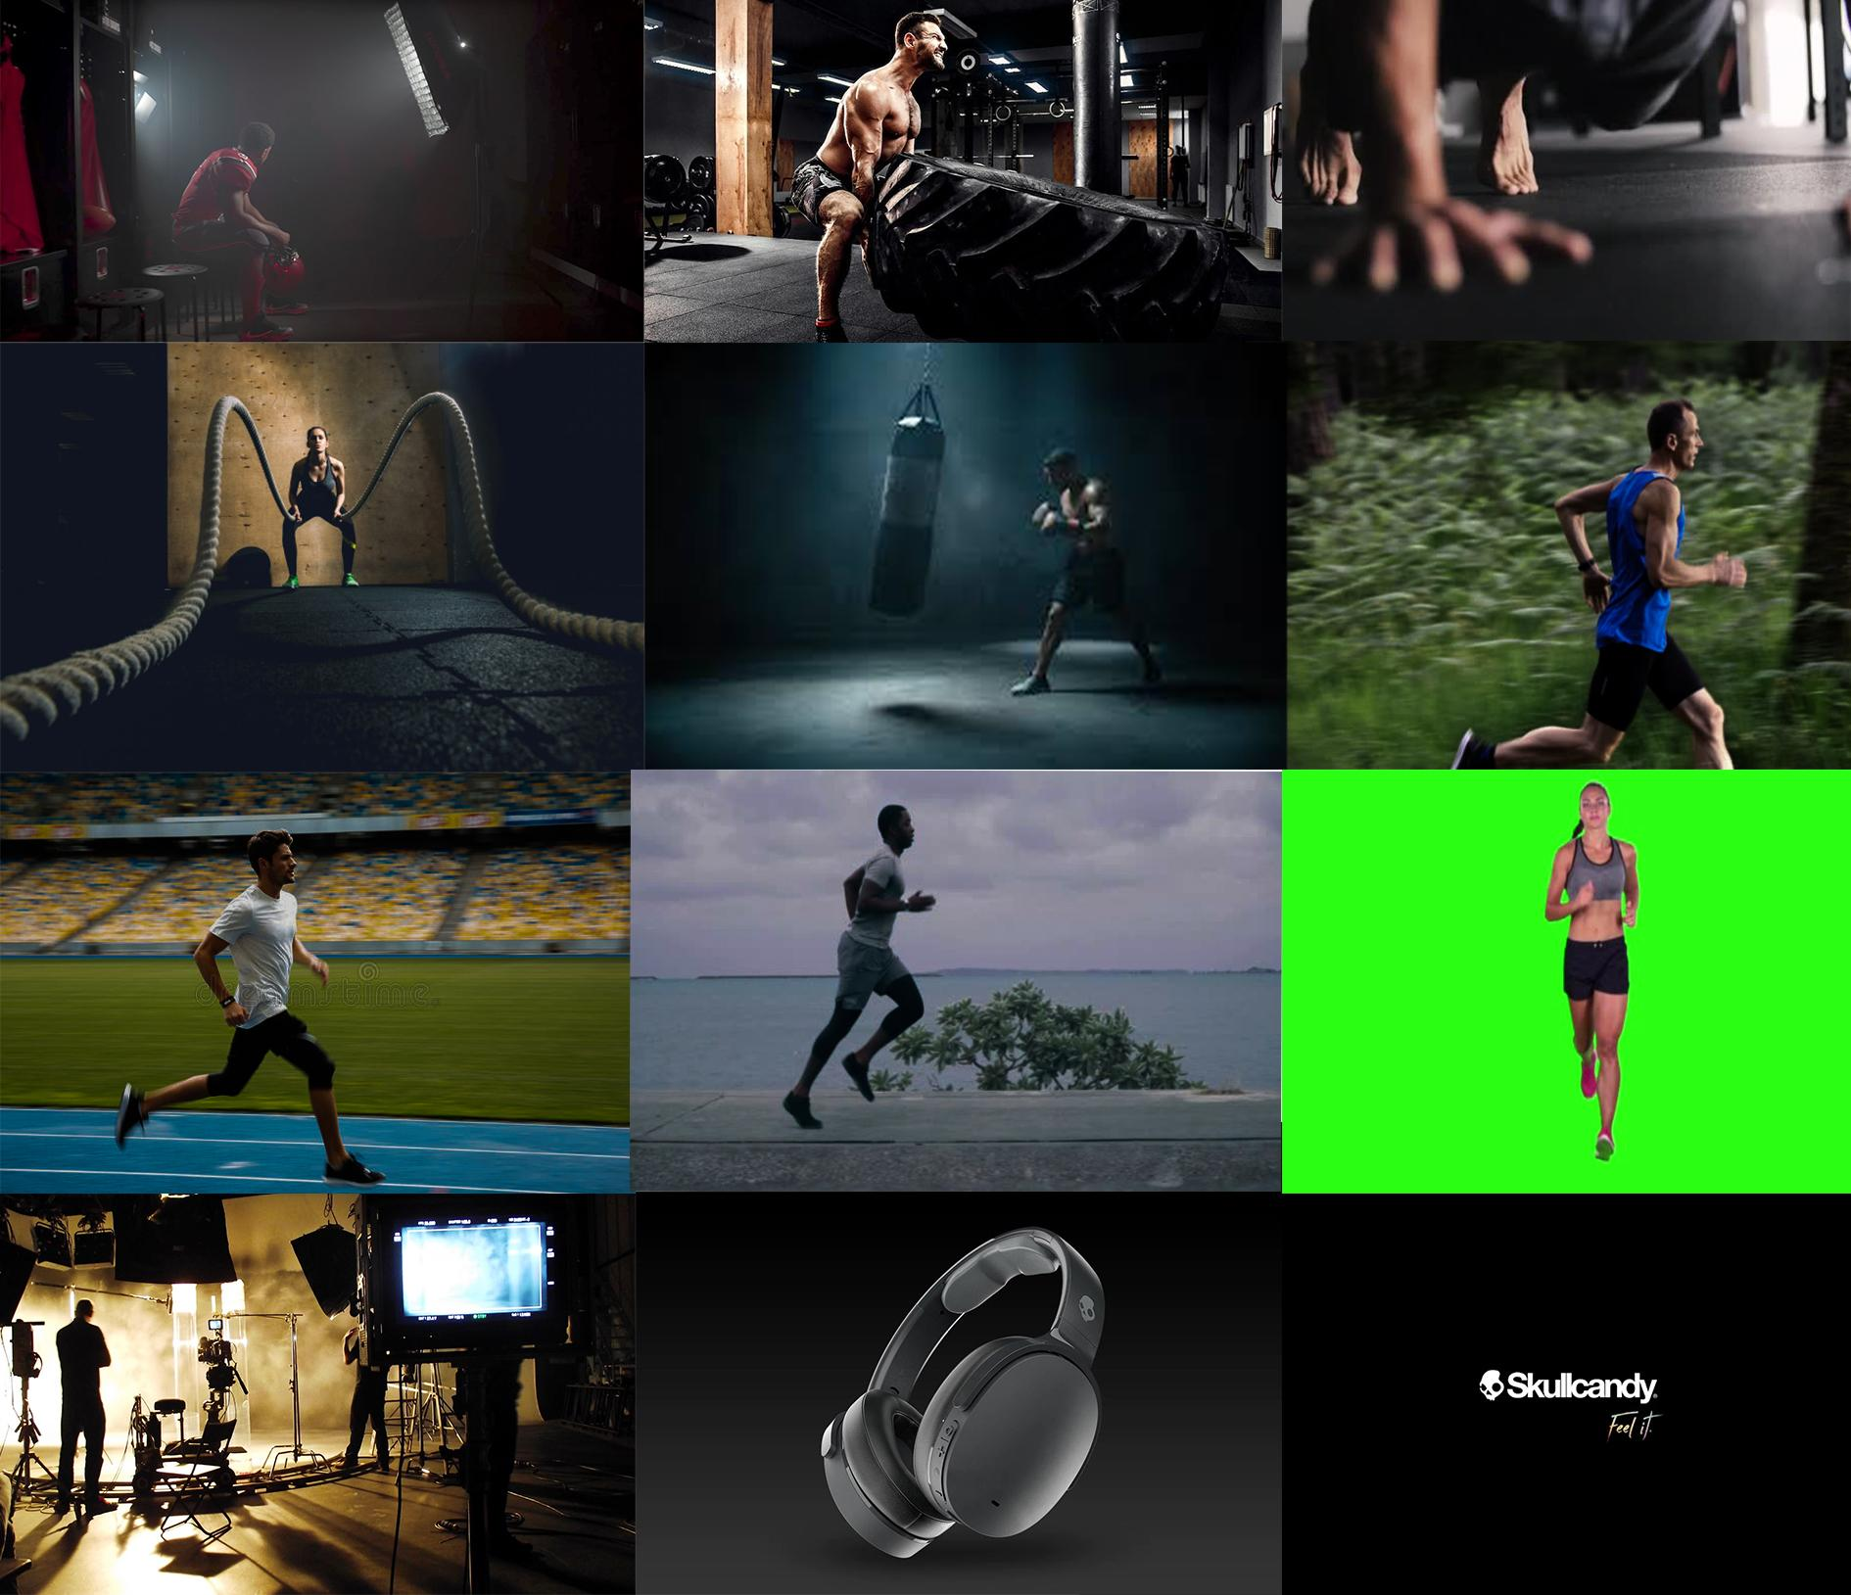
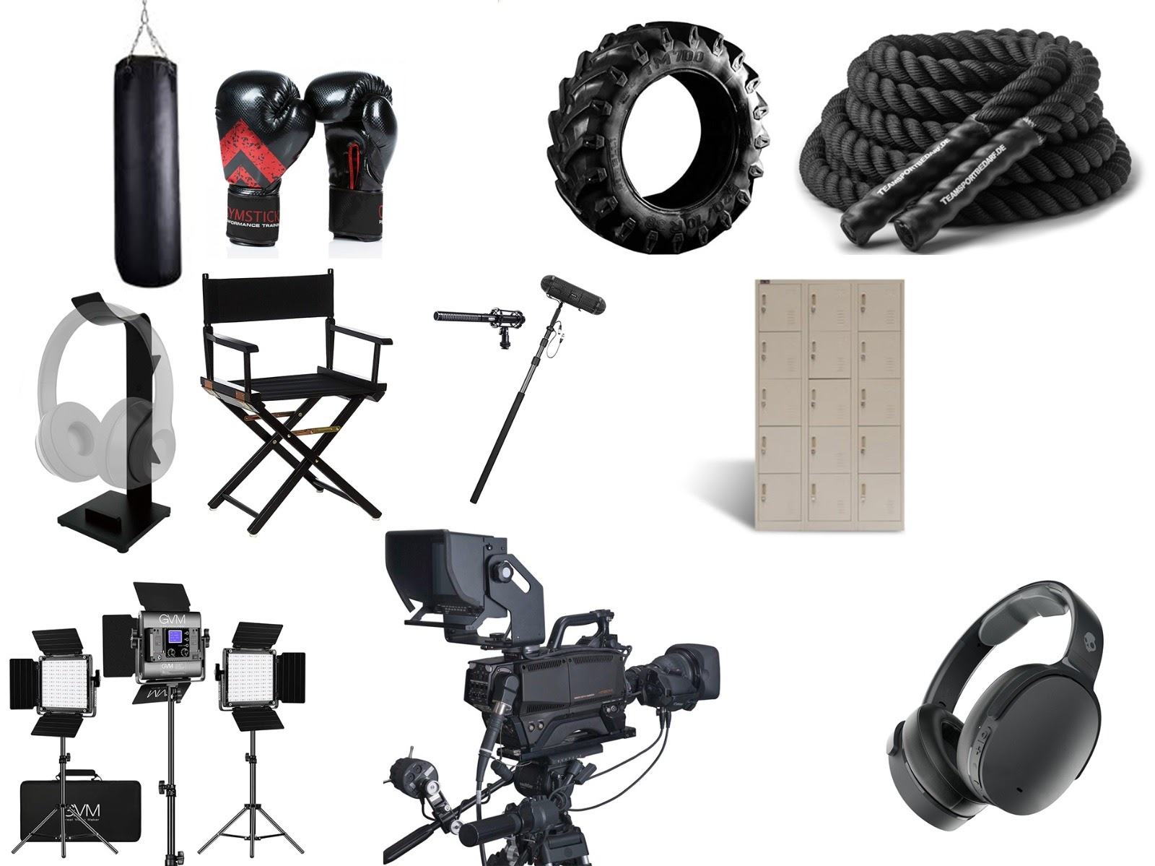
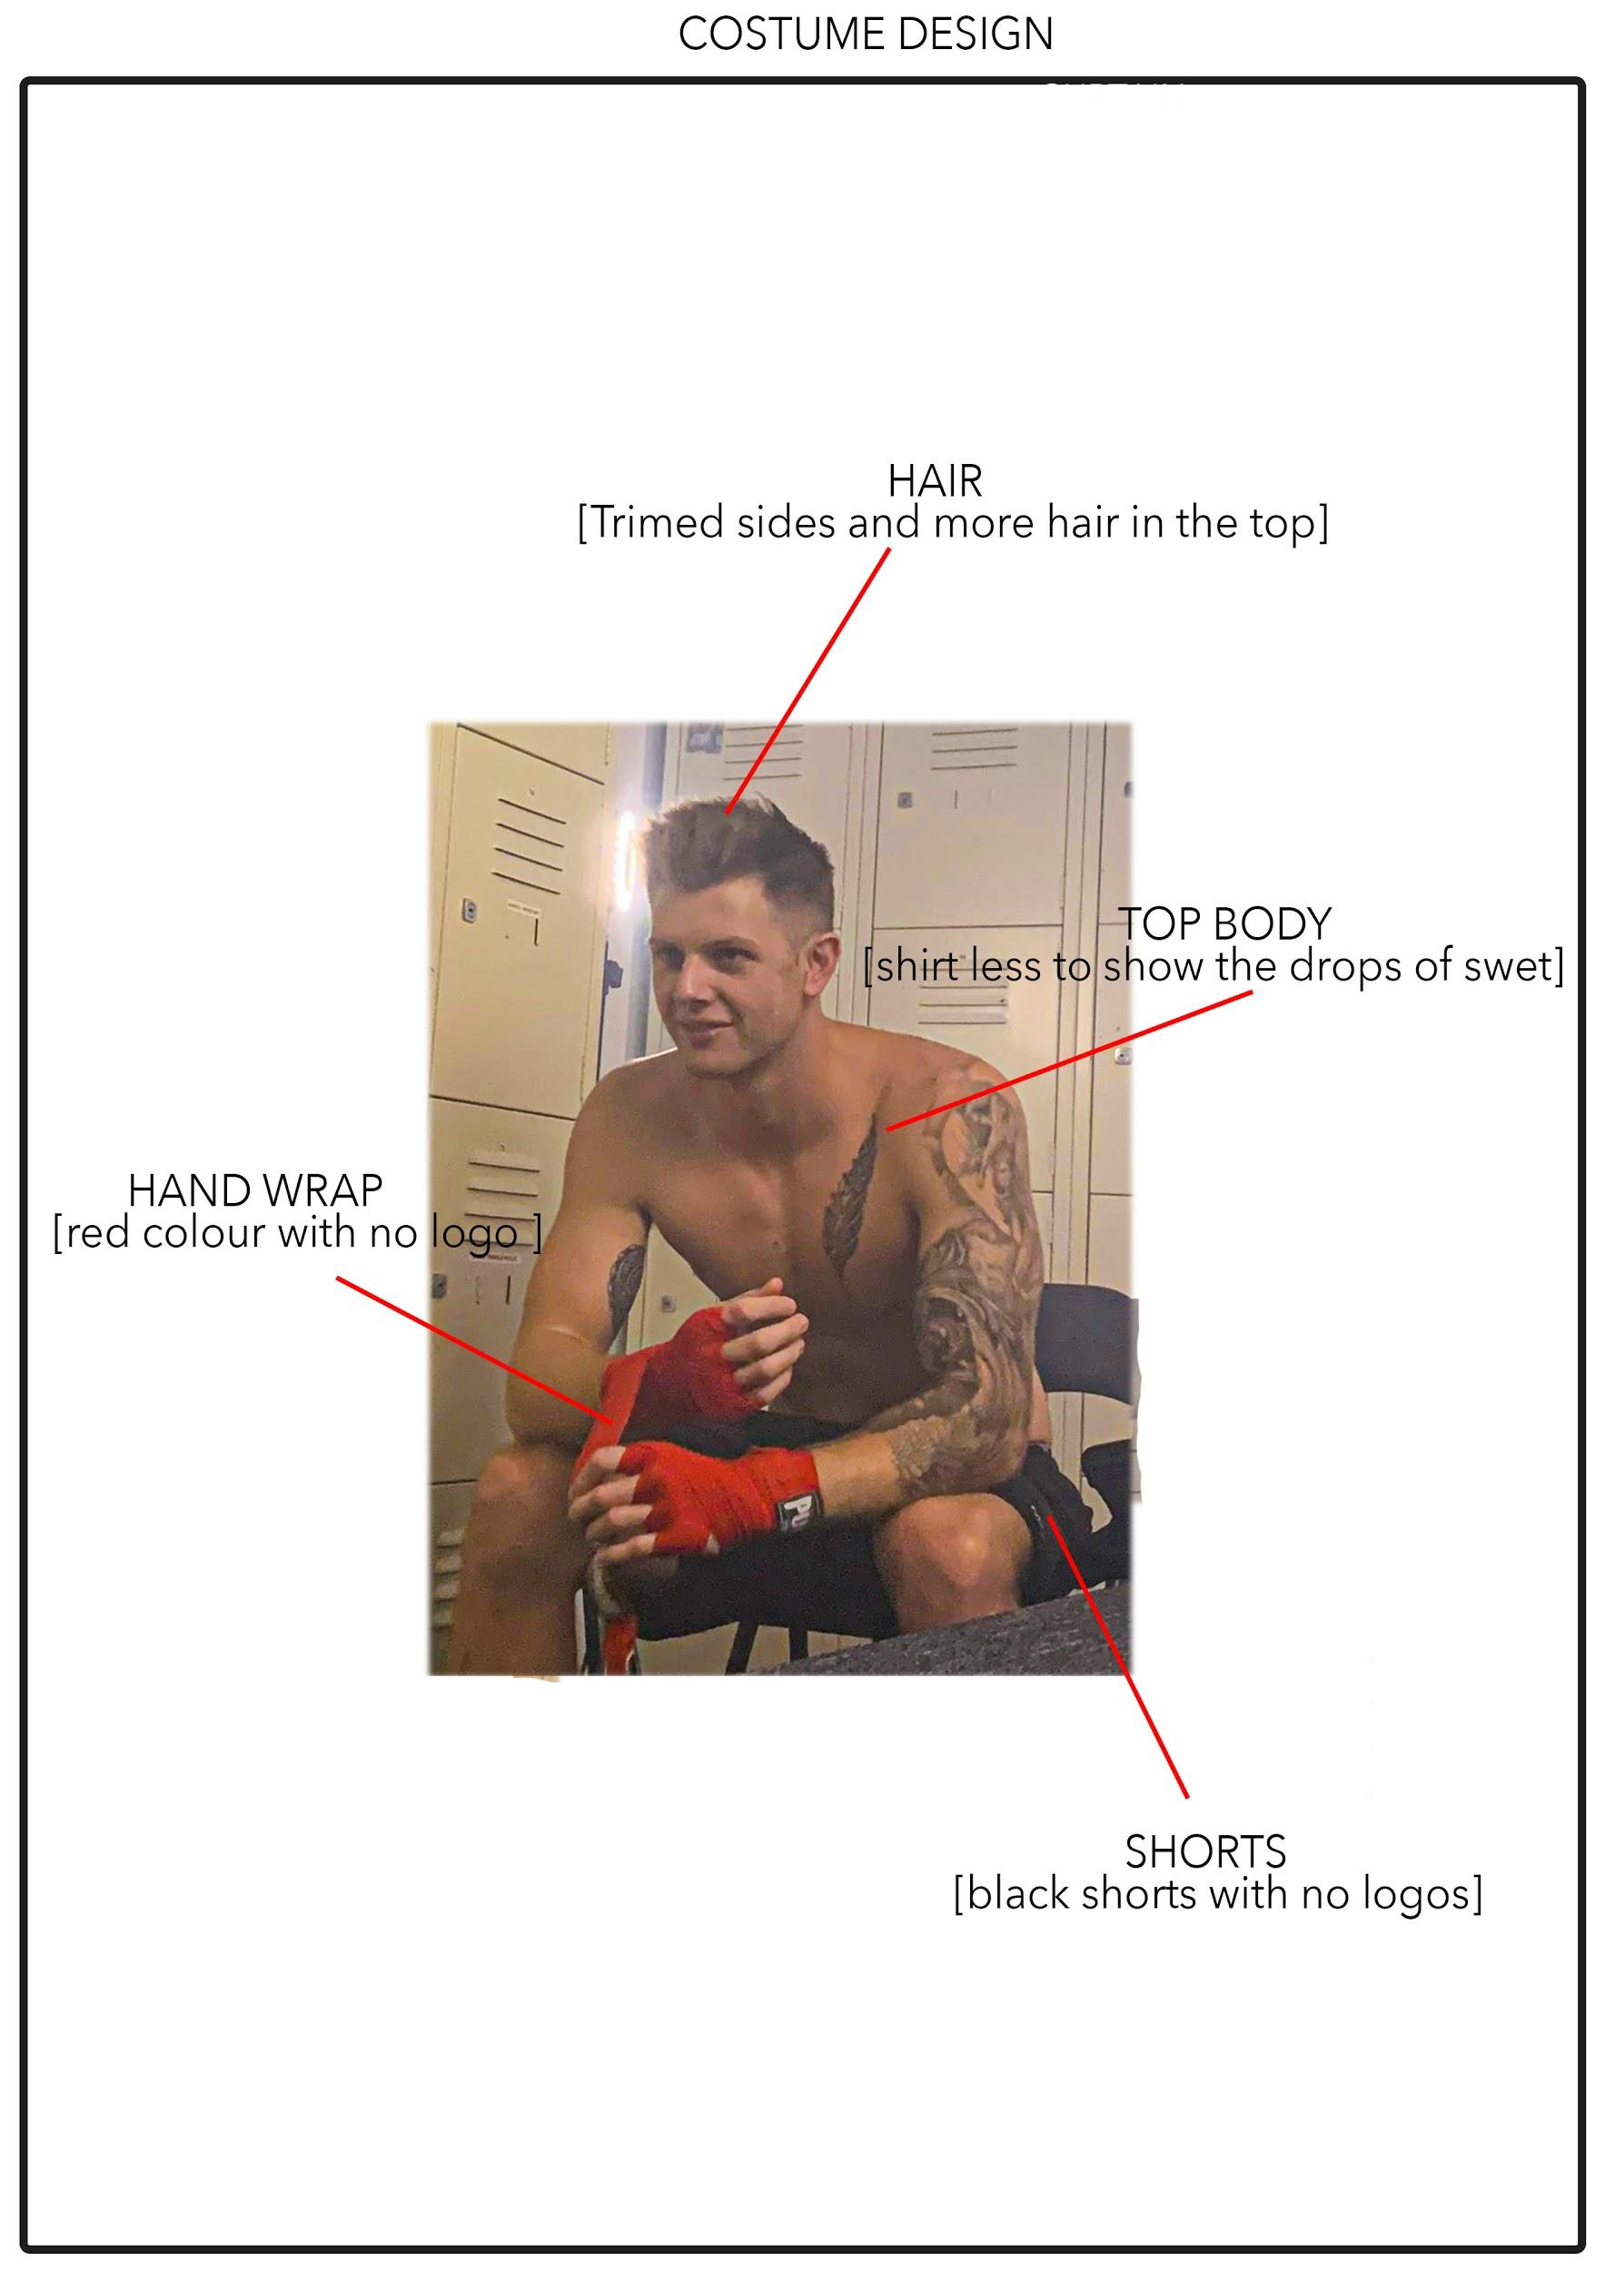
ART DIRECTION

Slide 10
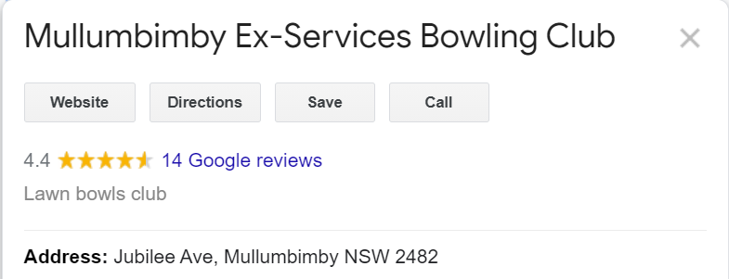
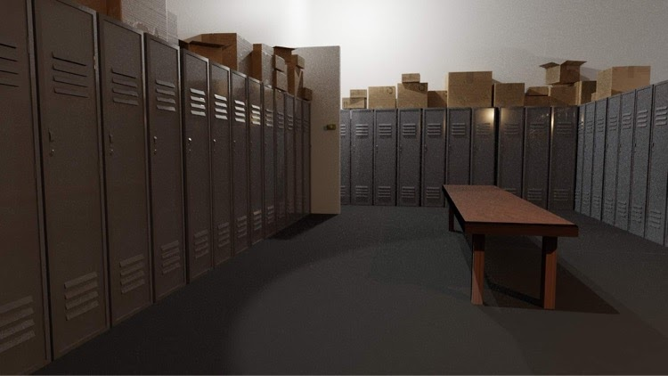
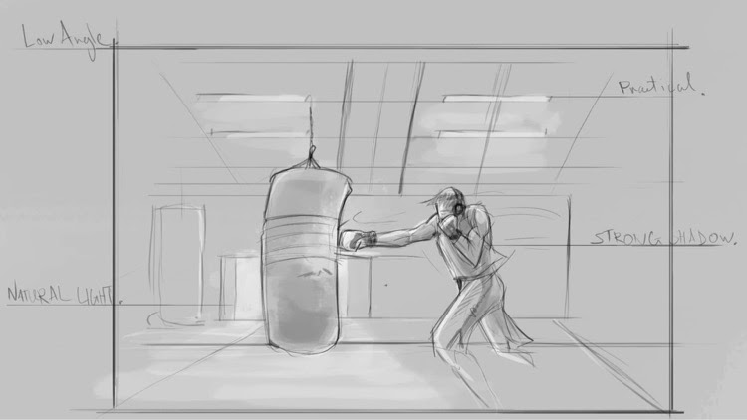
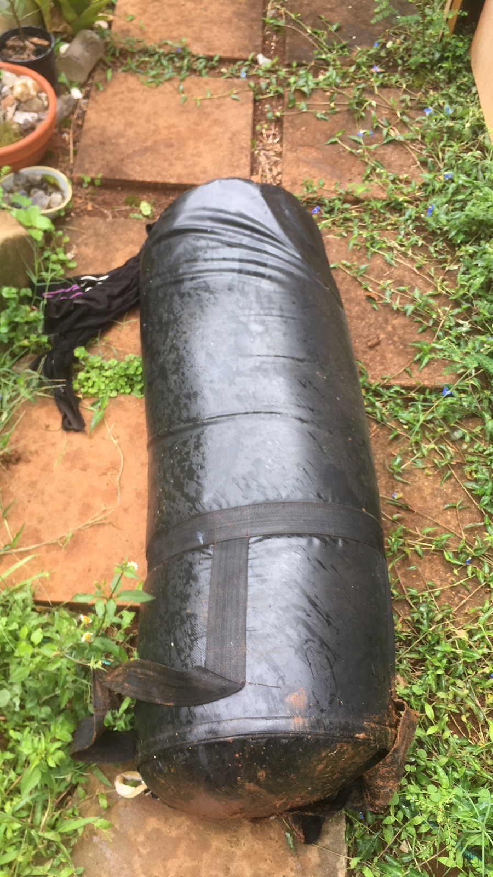
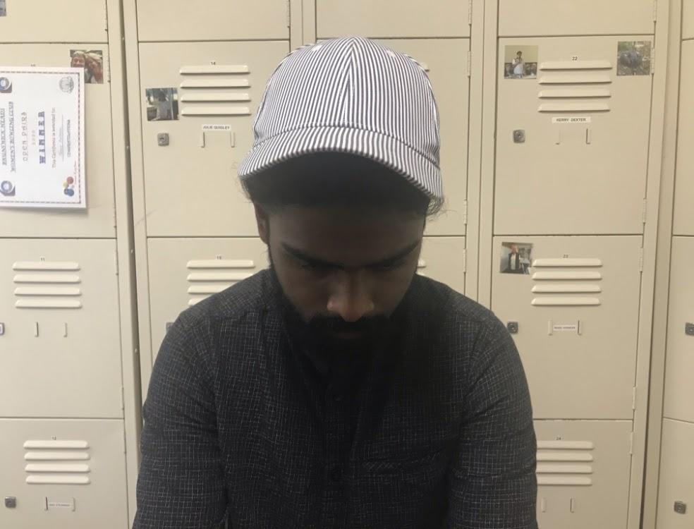
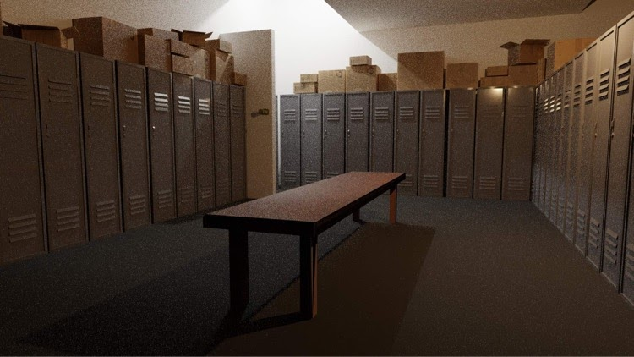
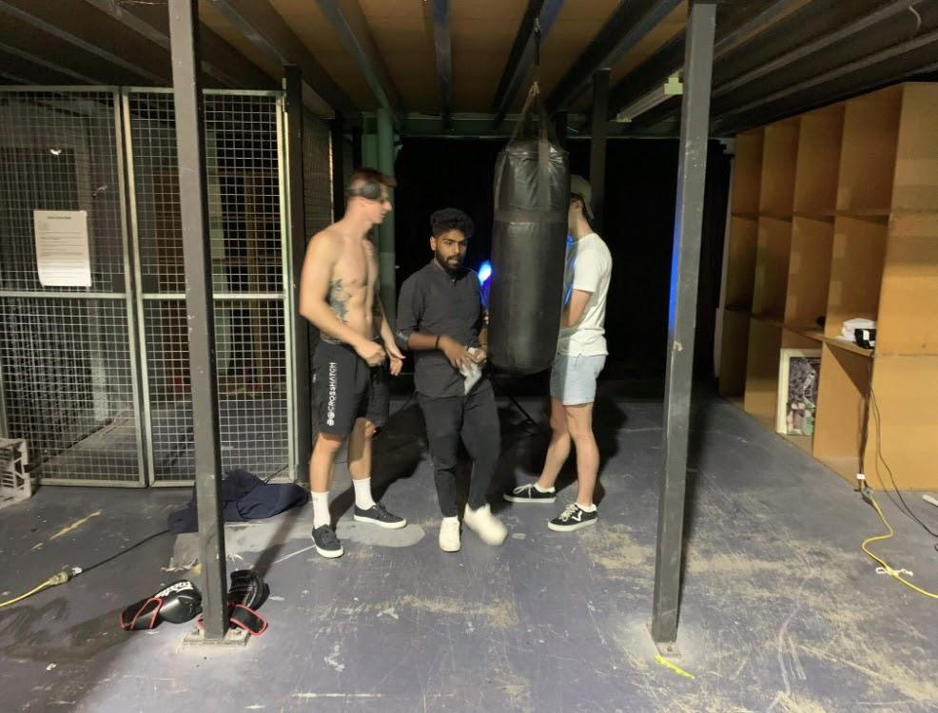
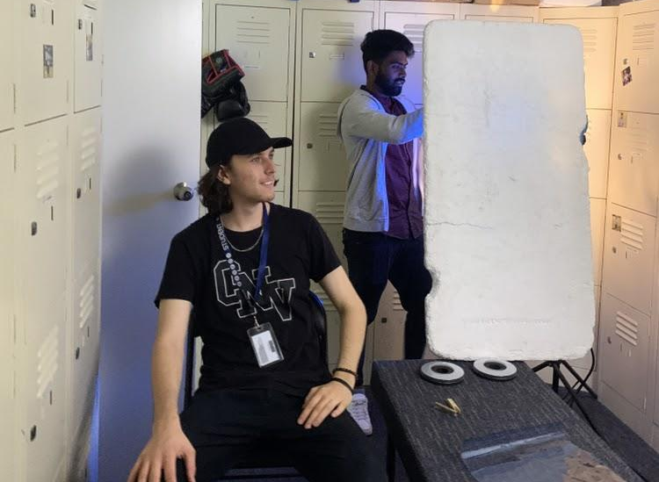
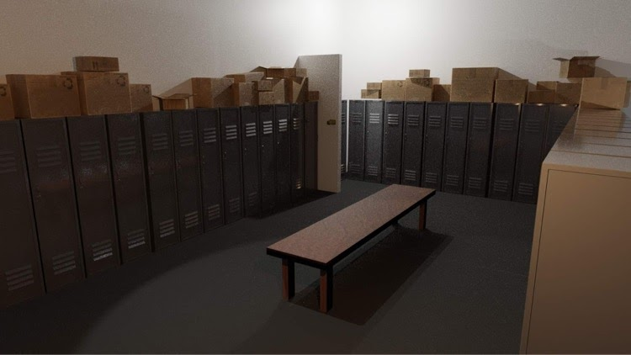
LOCATION SCOUTING

Slide 11
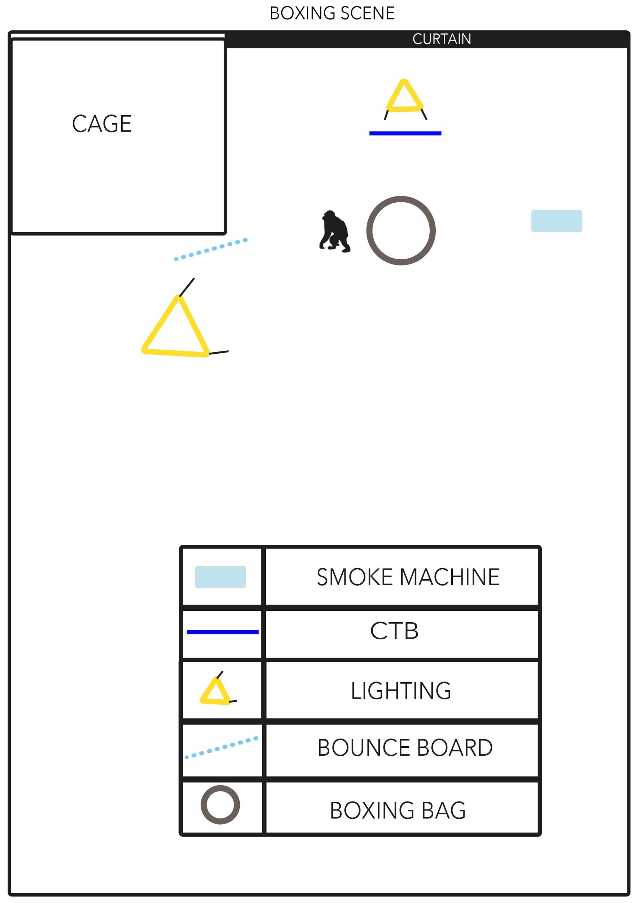
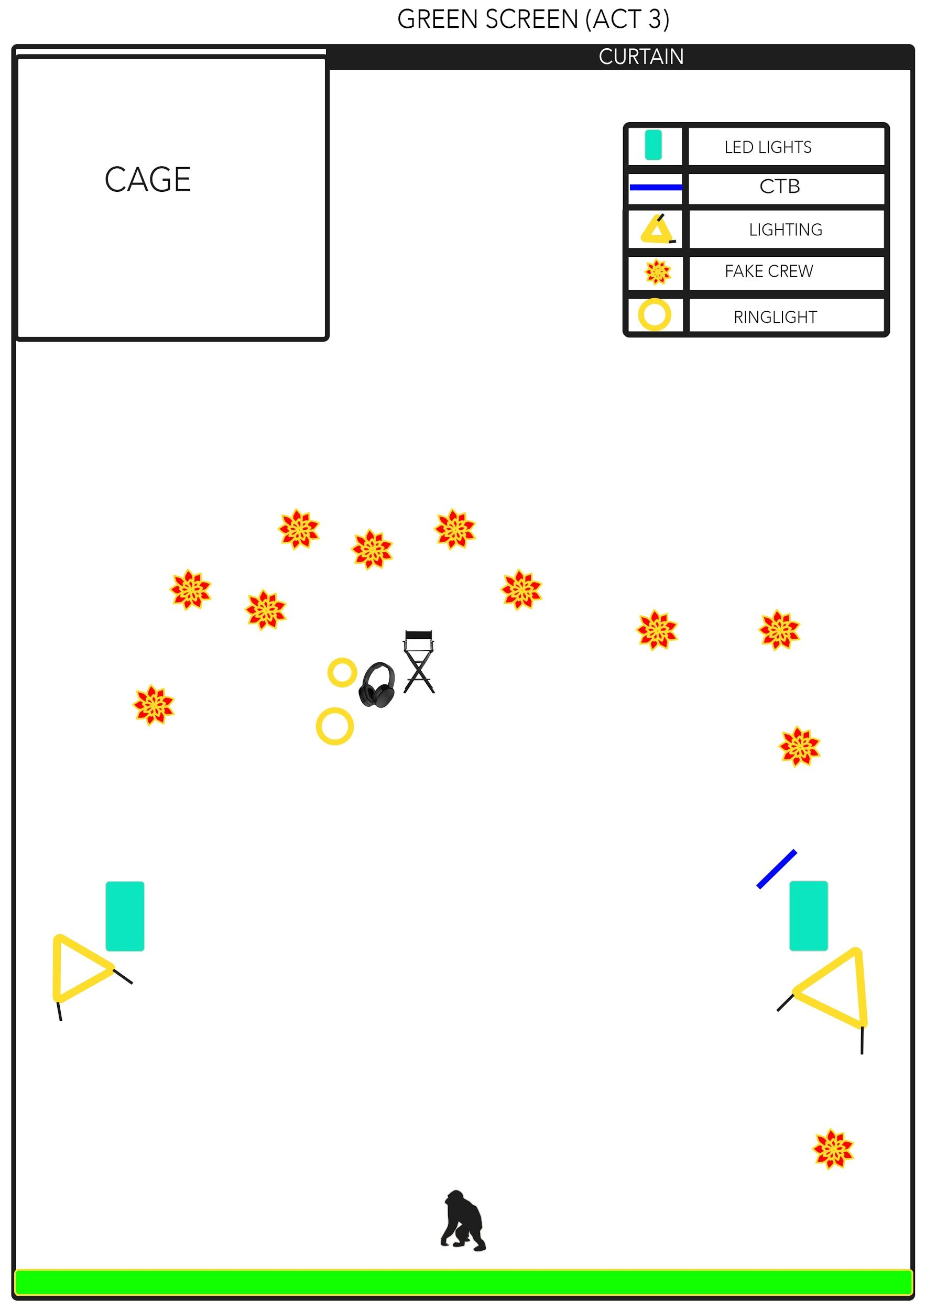
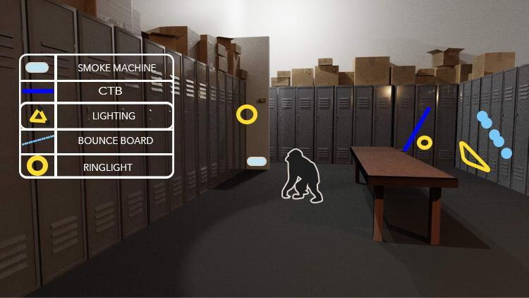
LIGHTING

Slide 12
CASTING
STAR NOW
LOCAL THEATRE
NETFLIX PRODUCTION

Slide 13
Previz NO.2

Slide 14
PRODUCTION

Slide 15
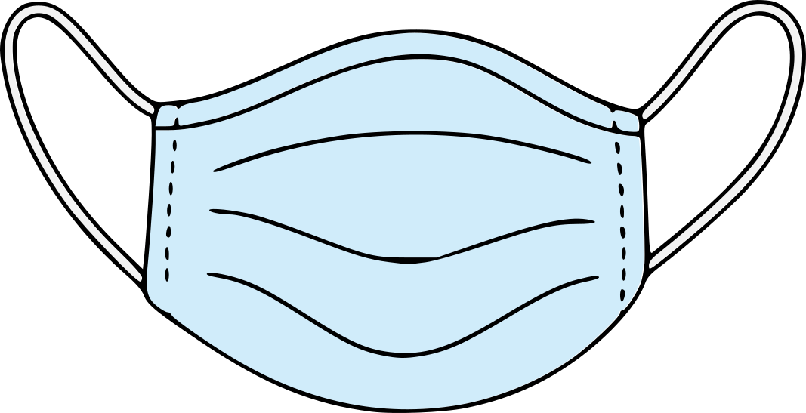
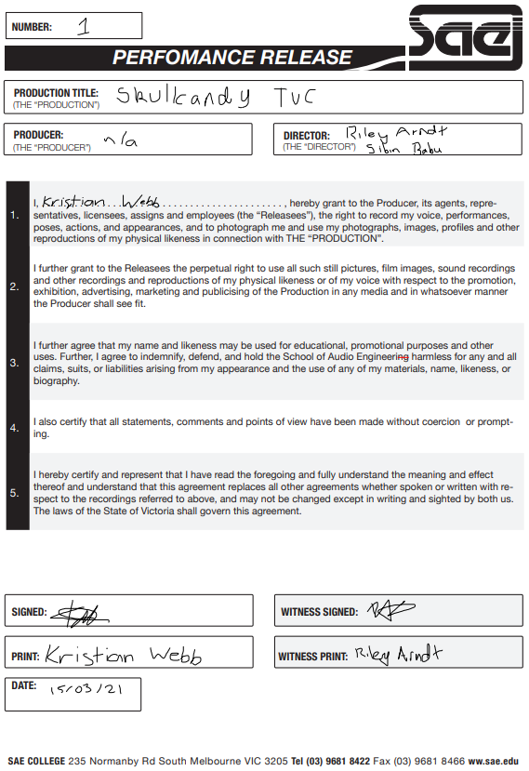
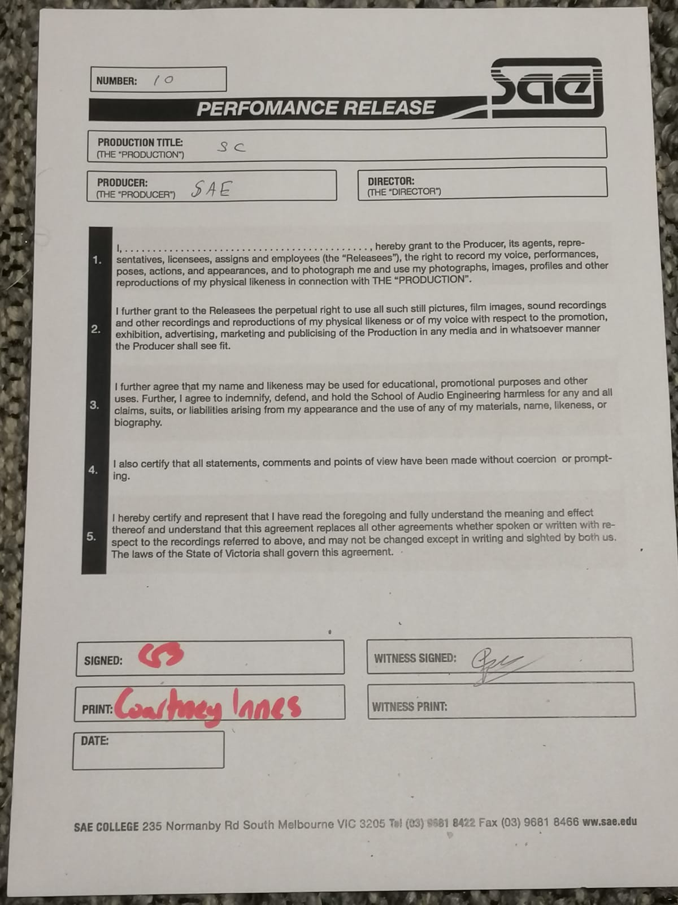
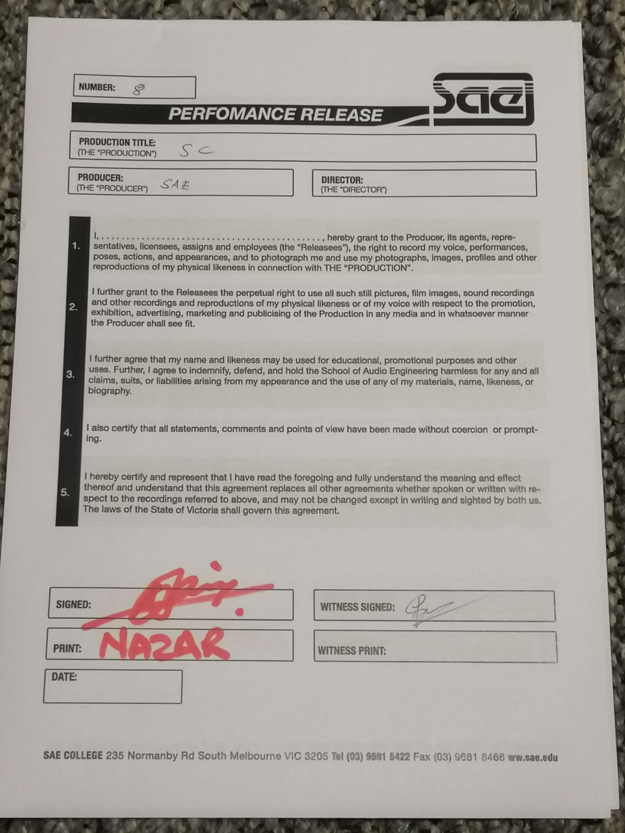
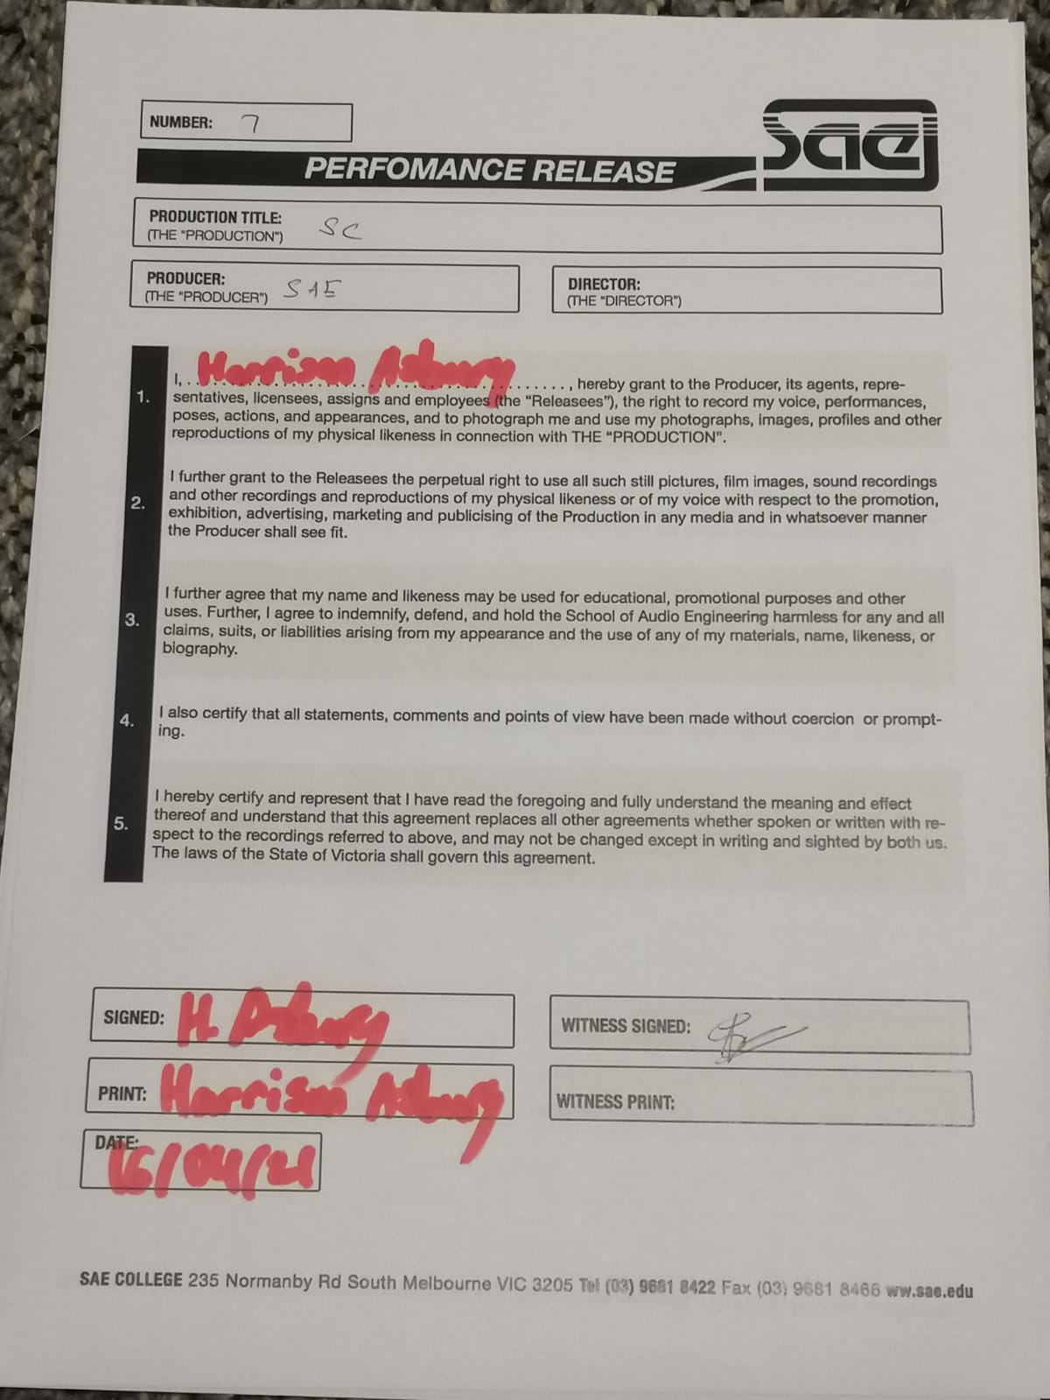
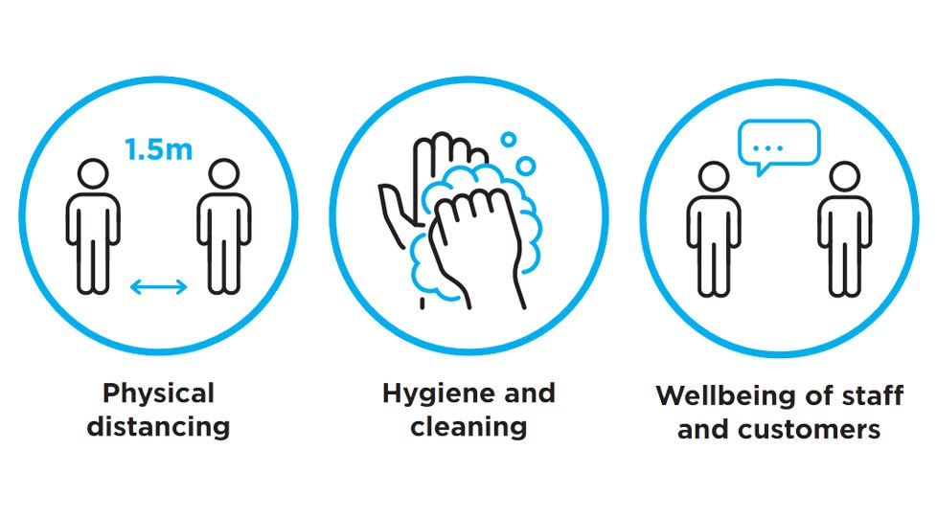
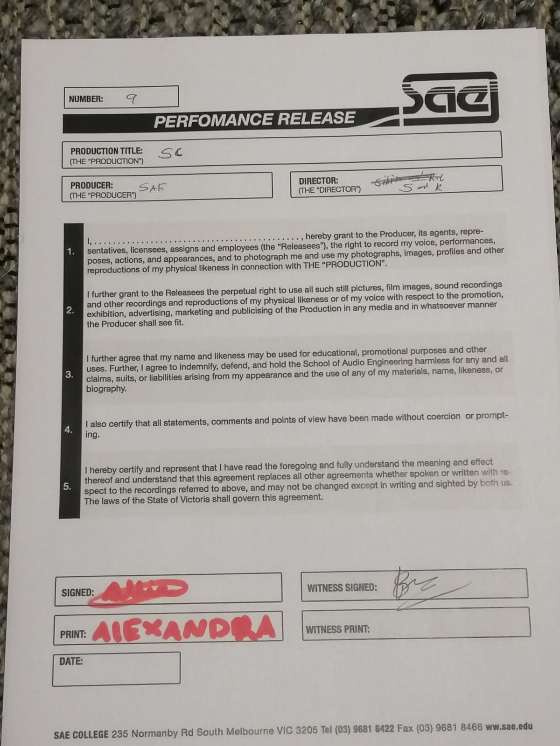
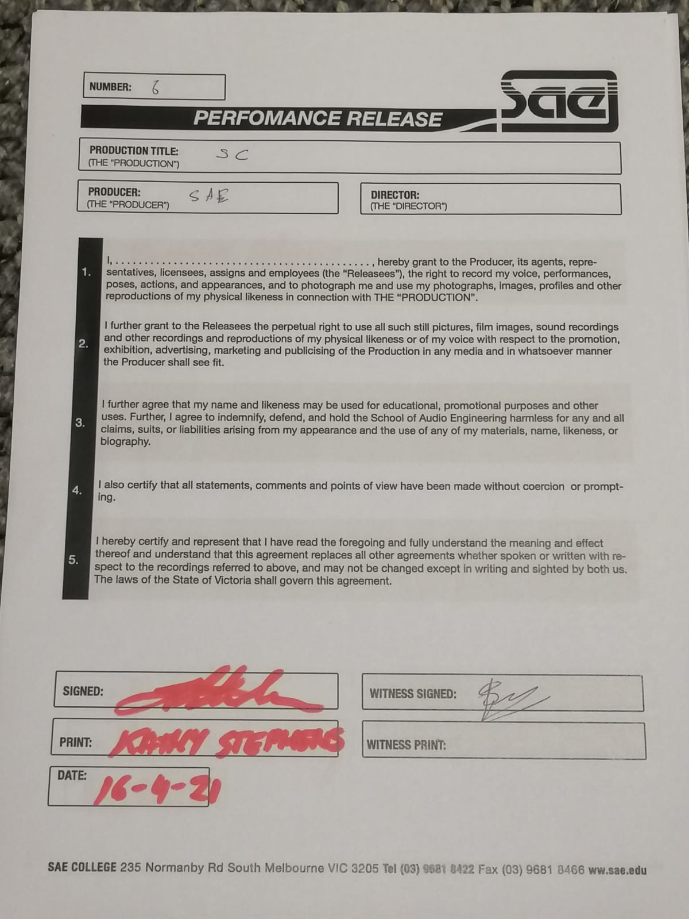
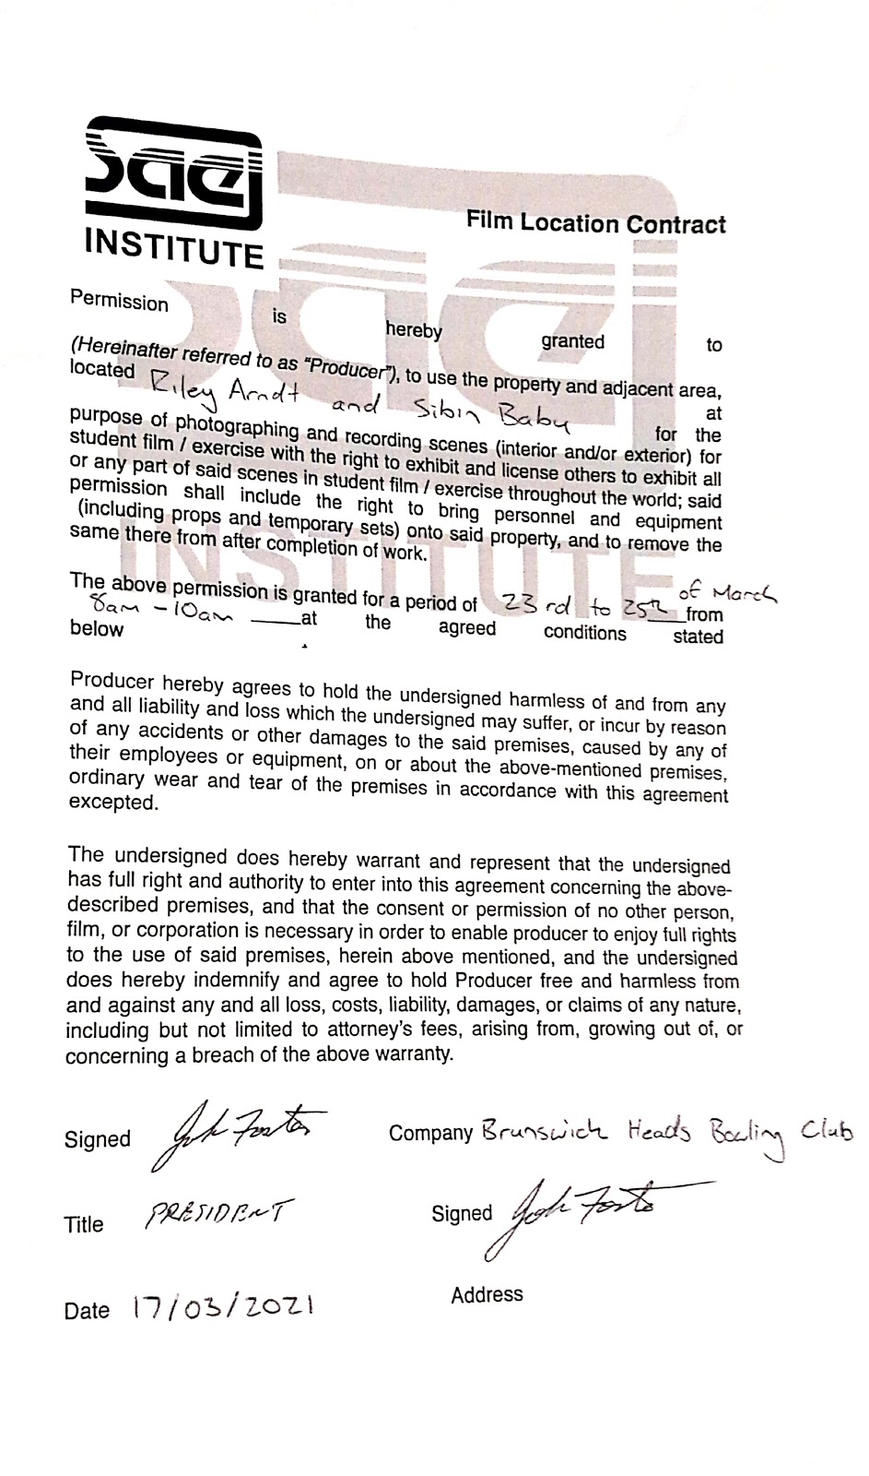
LEGAL CONTRACTS
ON-SET PROT COL

Slide 16
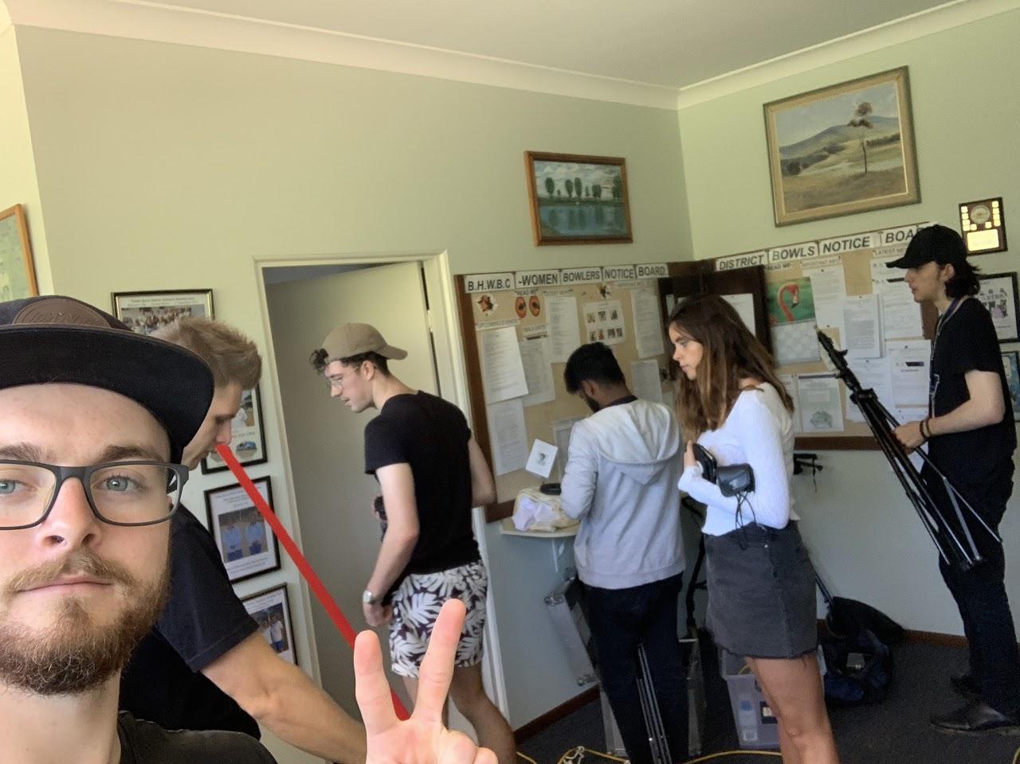
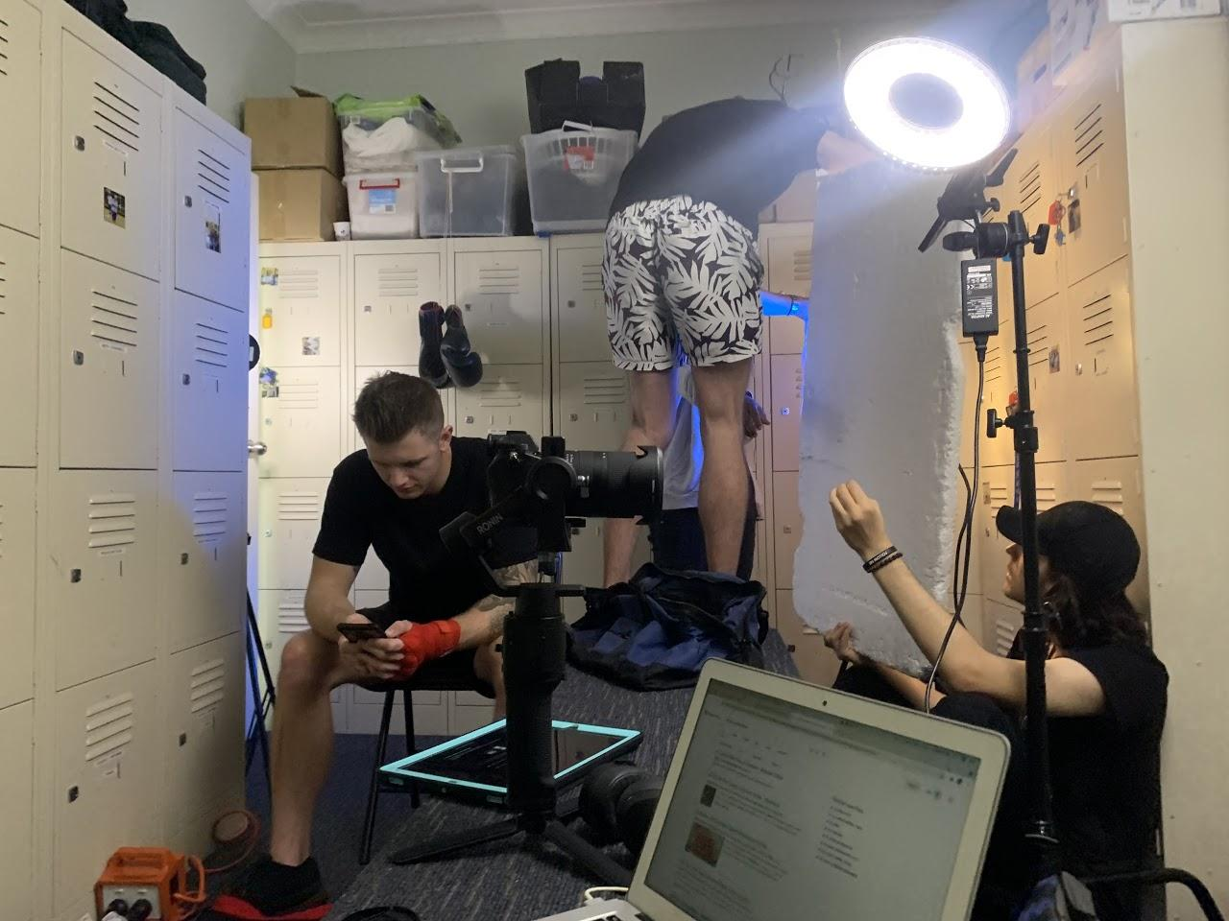
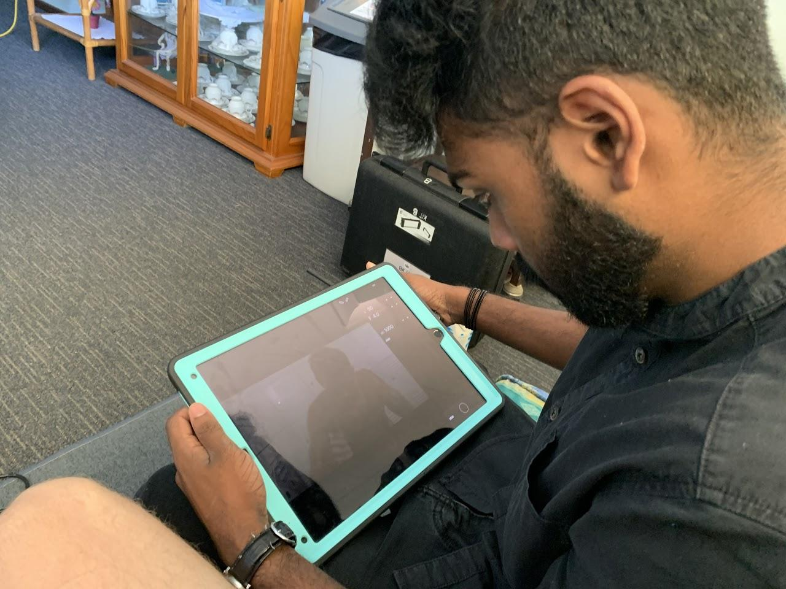
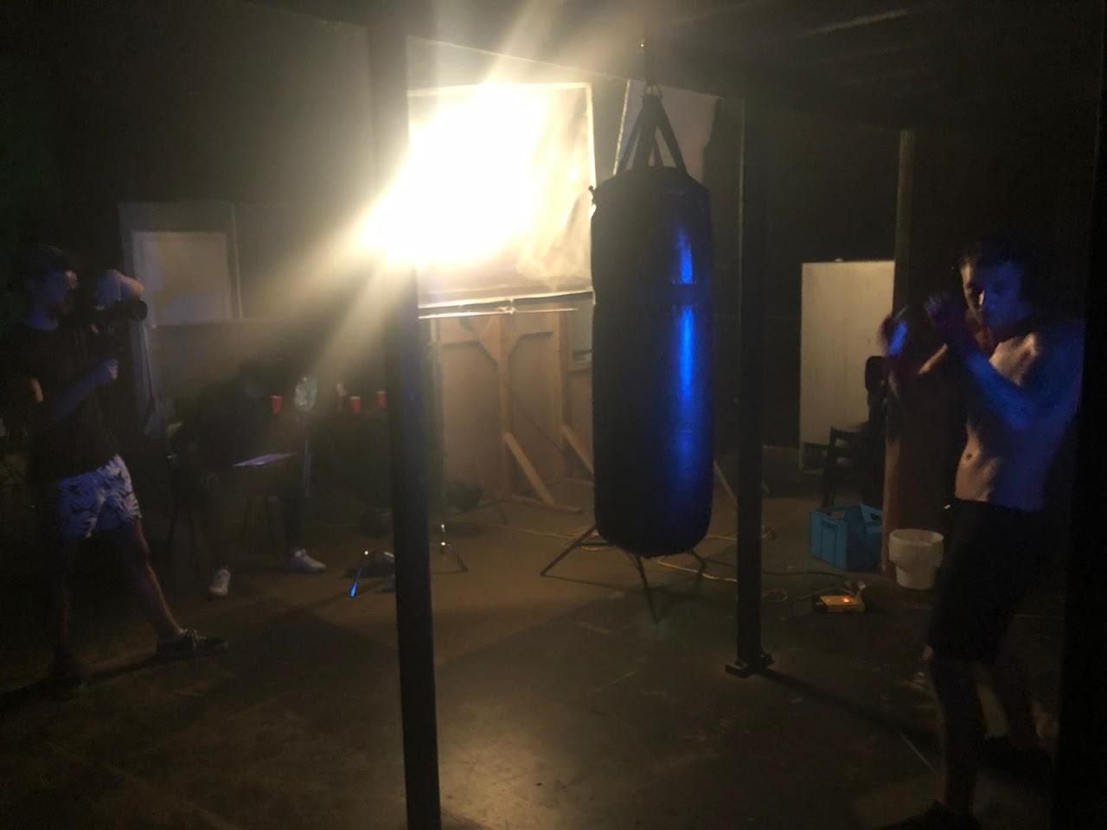
ON-SET
BEHIND THE SCENES

Slide 17
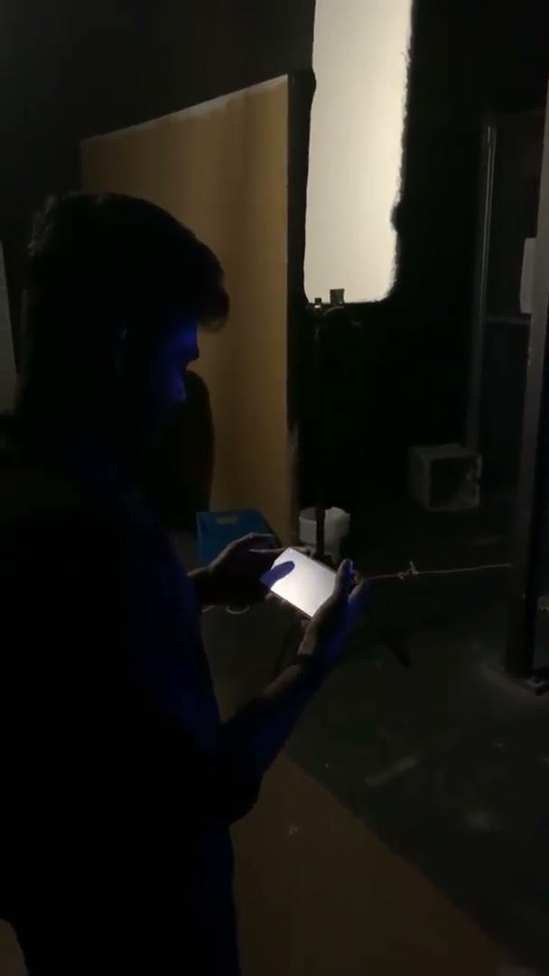
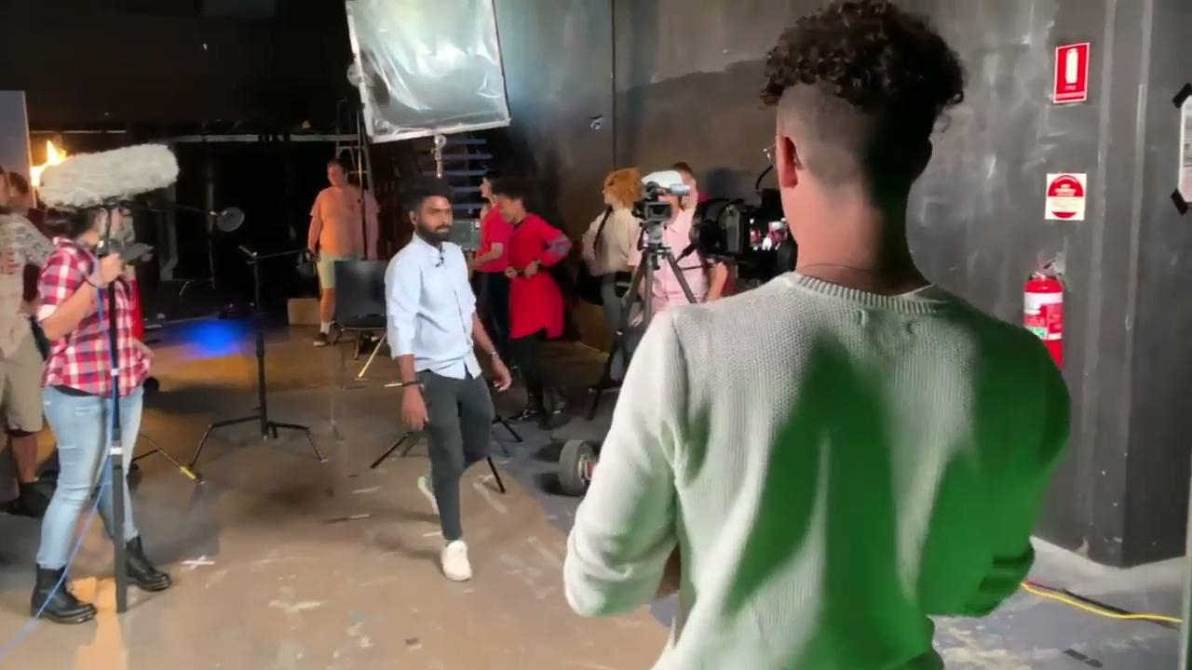
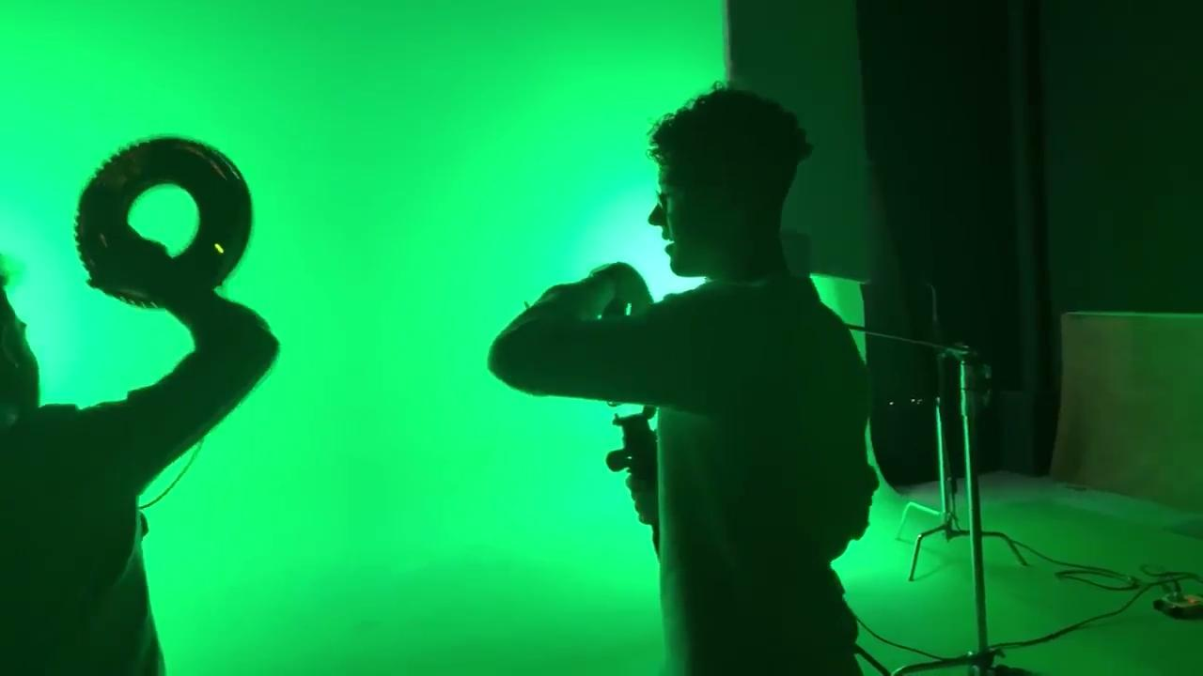
ON-SET
BEHIND THE SCENES

Slide 18
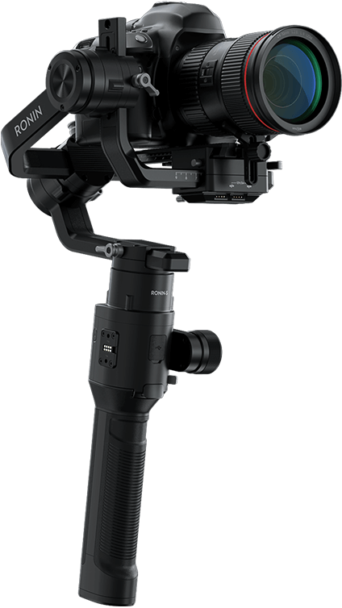
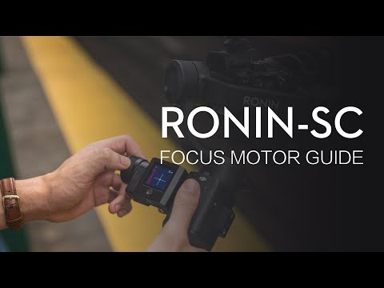
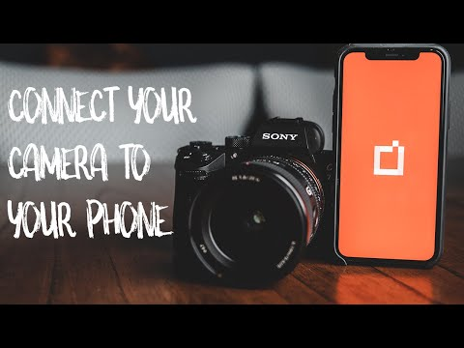
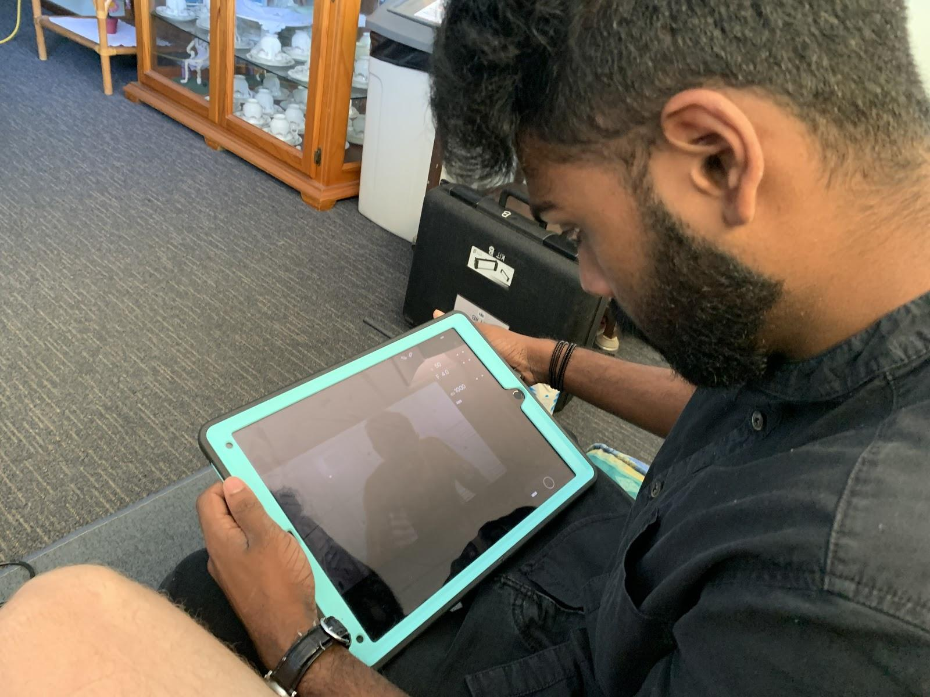
EQUIPMENT CHALLENGES
MANUAL FOCUS
WIRELESS MONITOR

Slide 19
POST-PRODUCTION

Slide 20
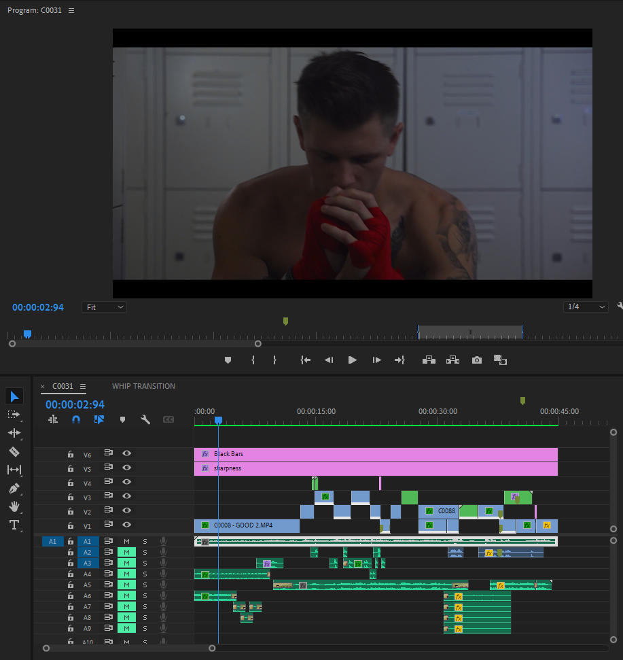
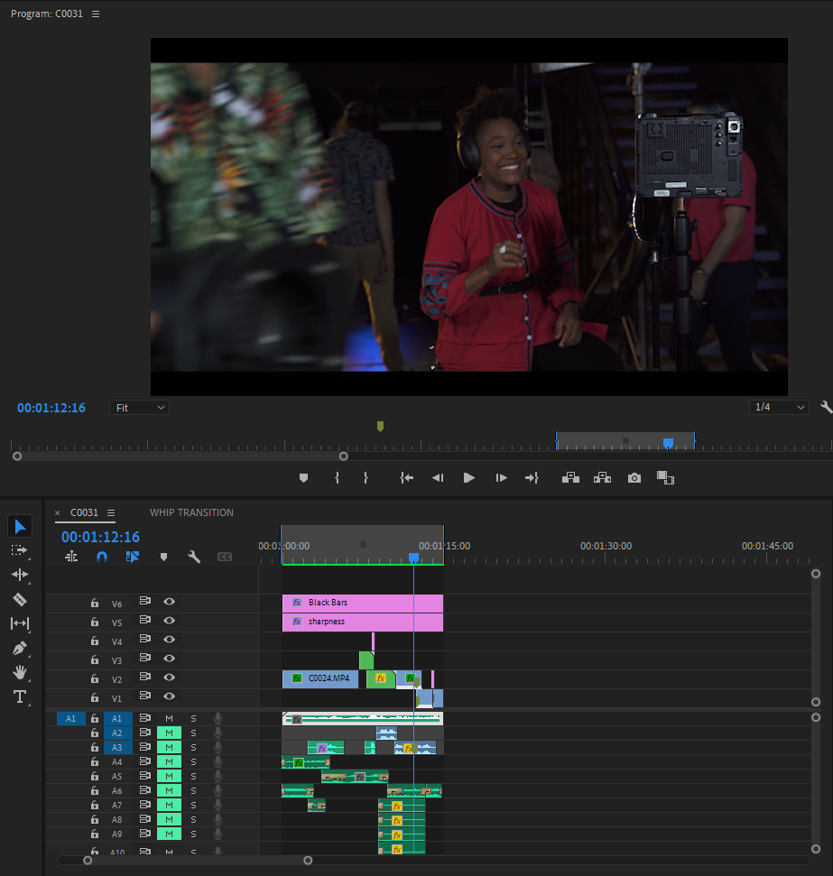
EDITING
45 SECONDS
15 SECONDS

Slide 21
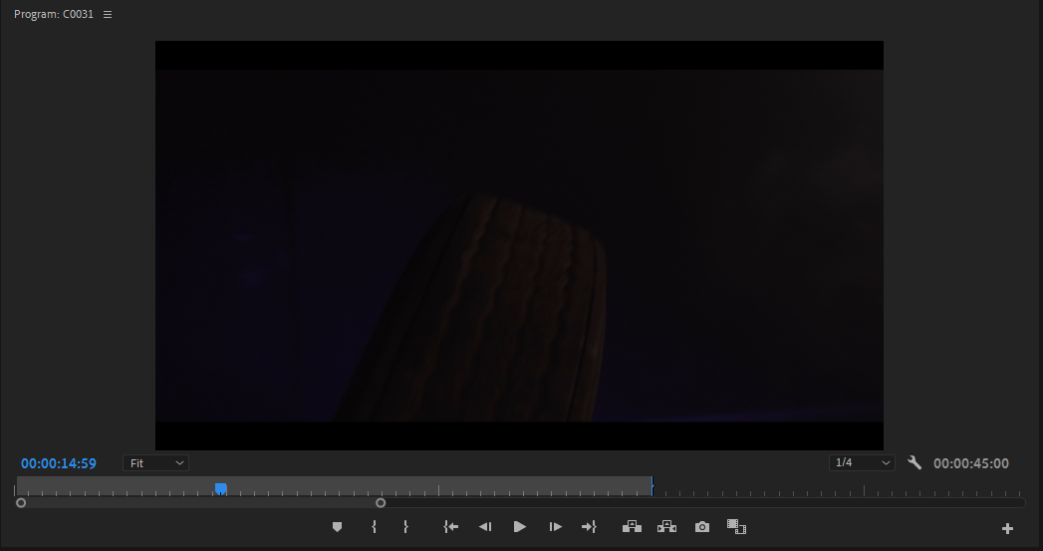
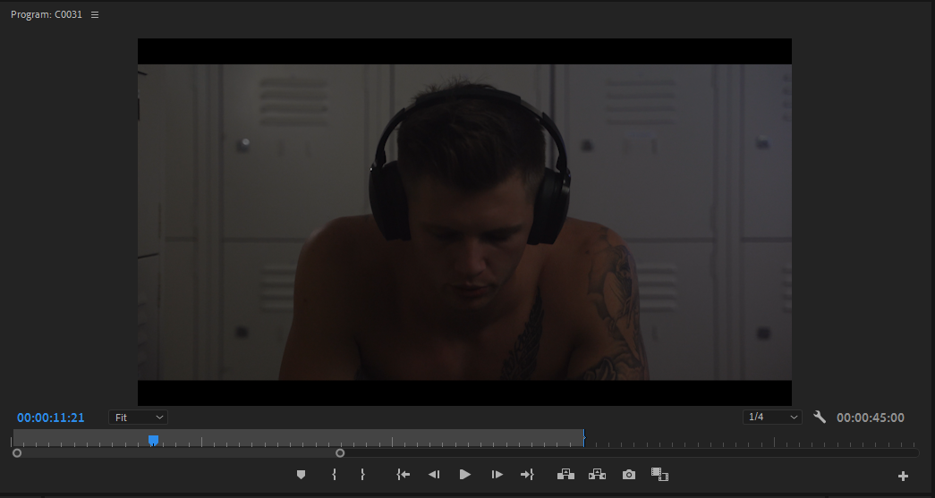
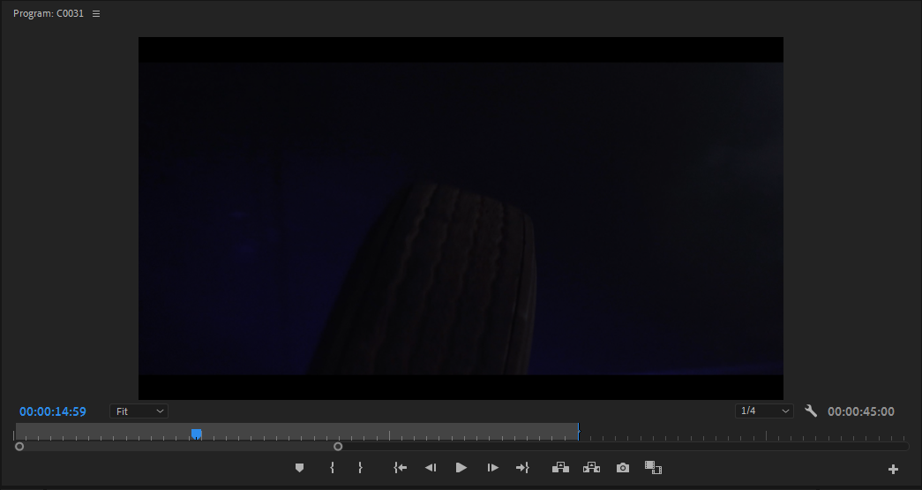
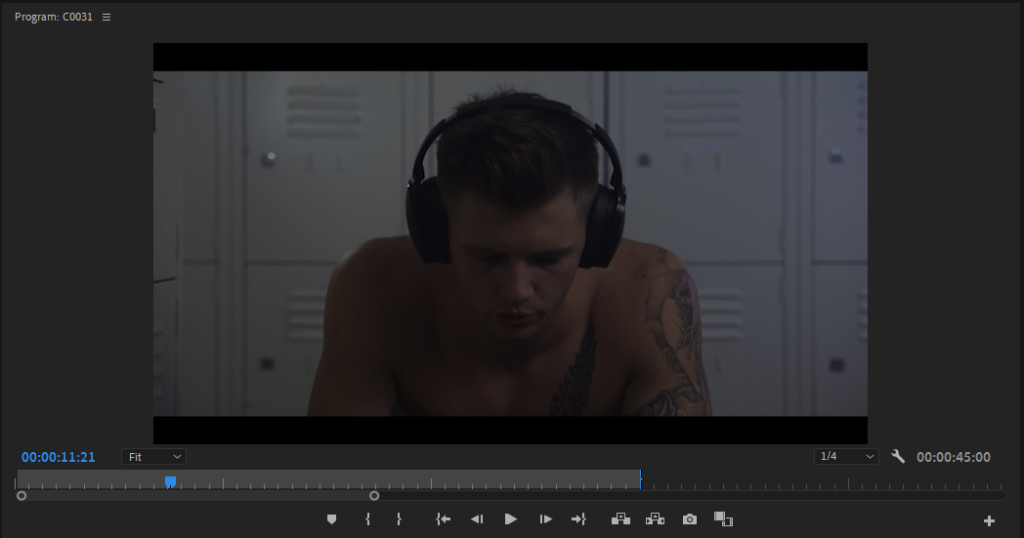
COLOUR GRADING

Slide 22
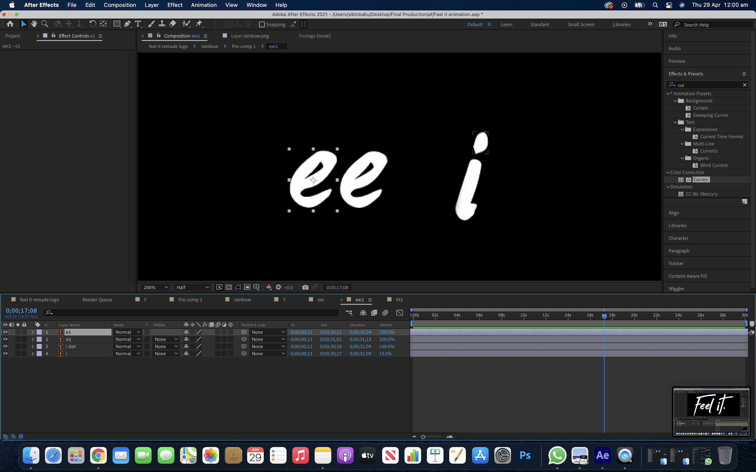
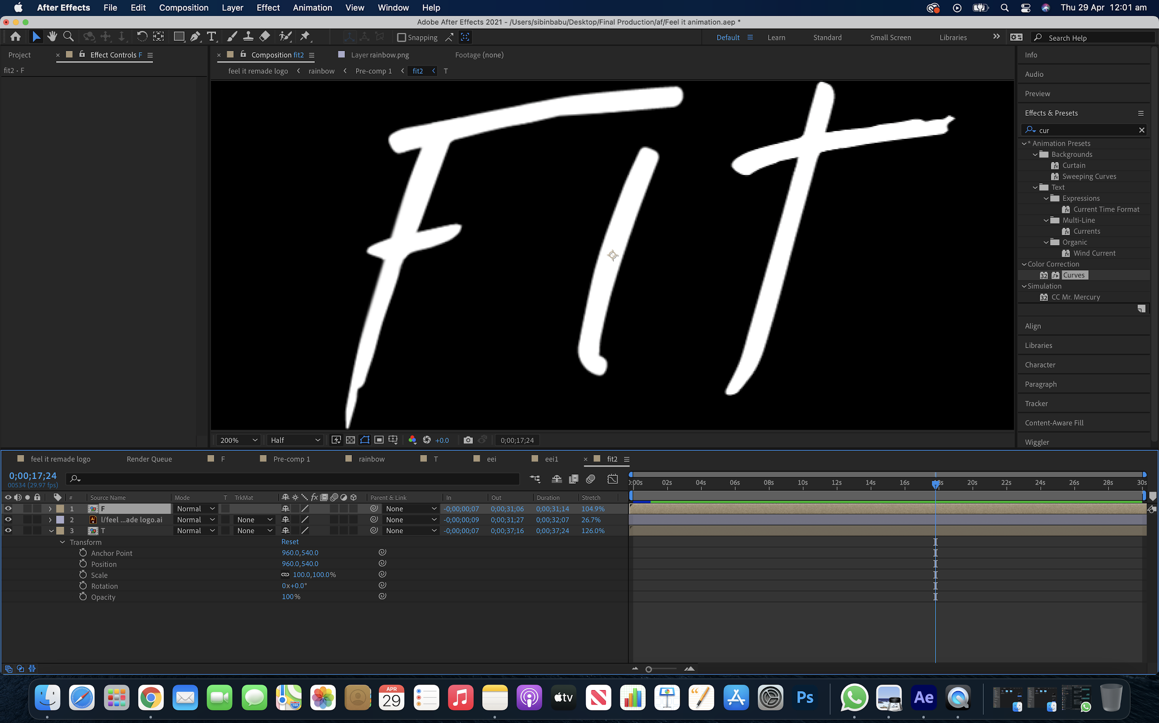
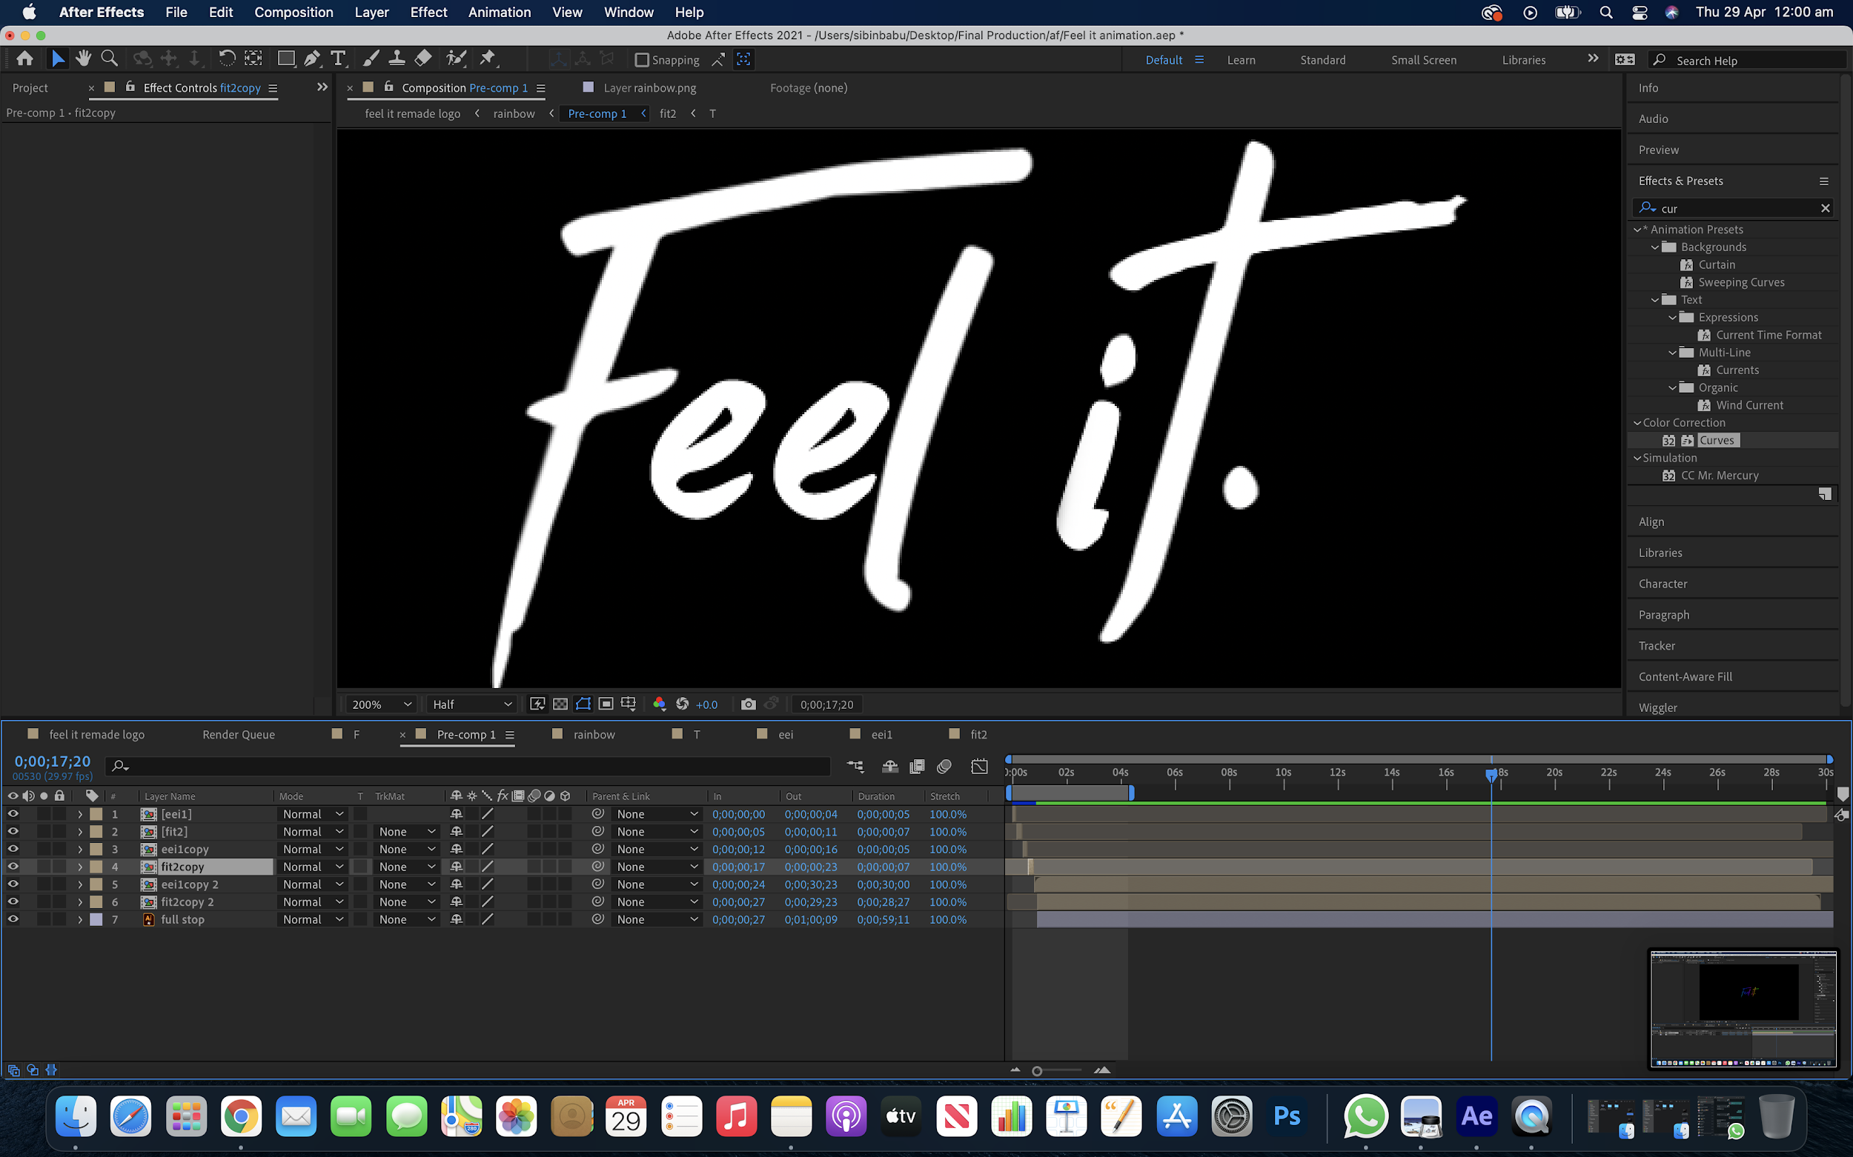
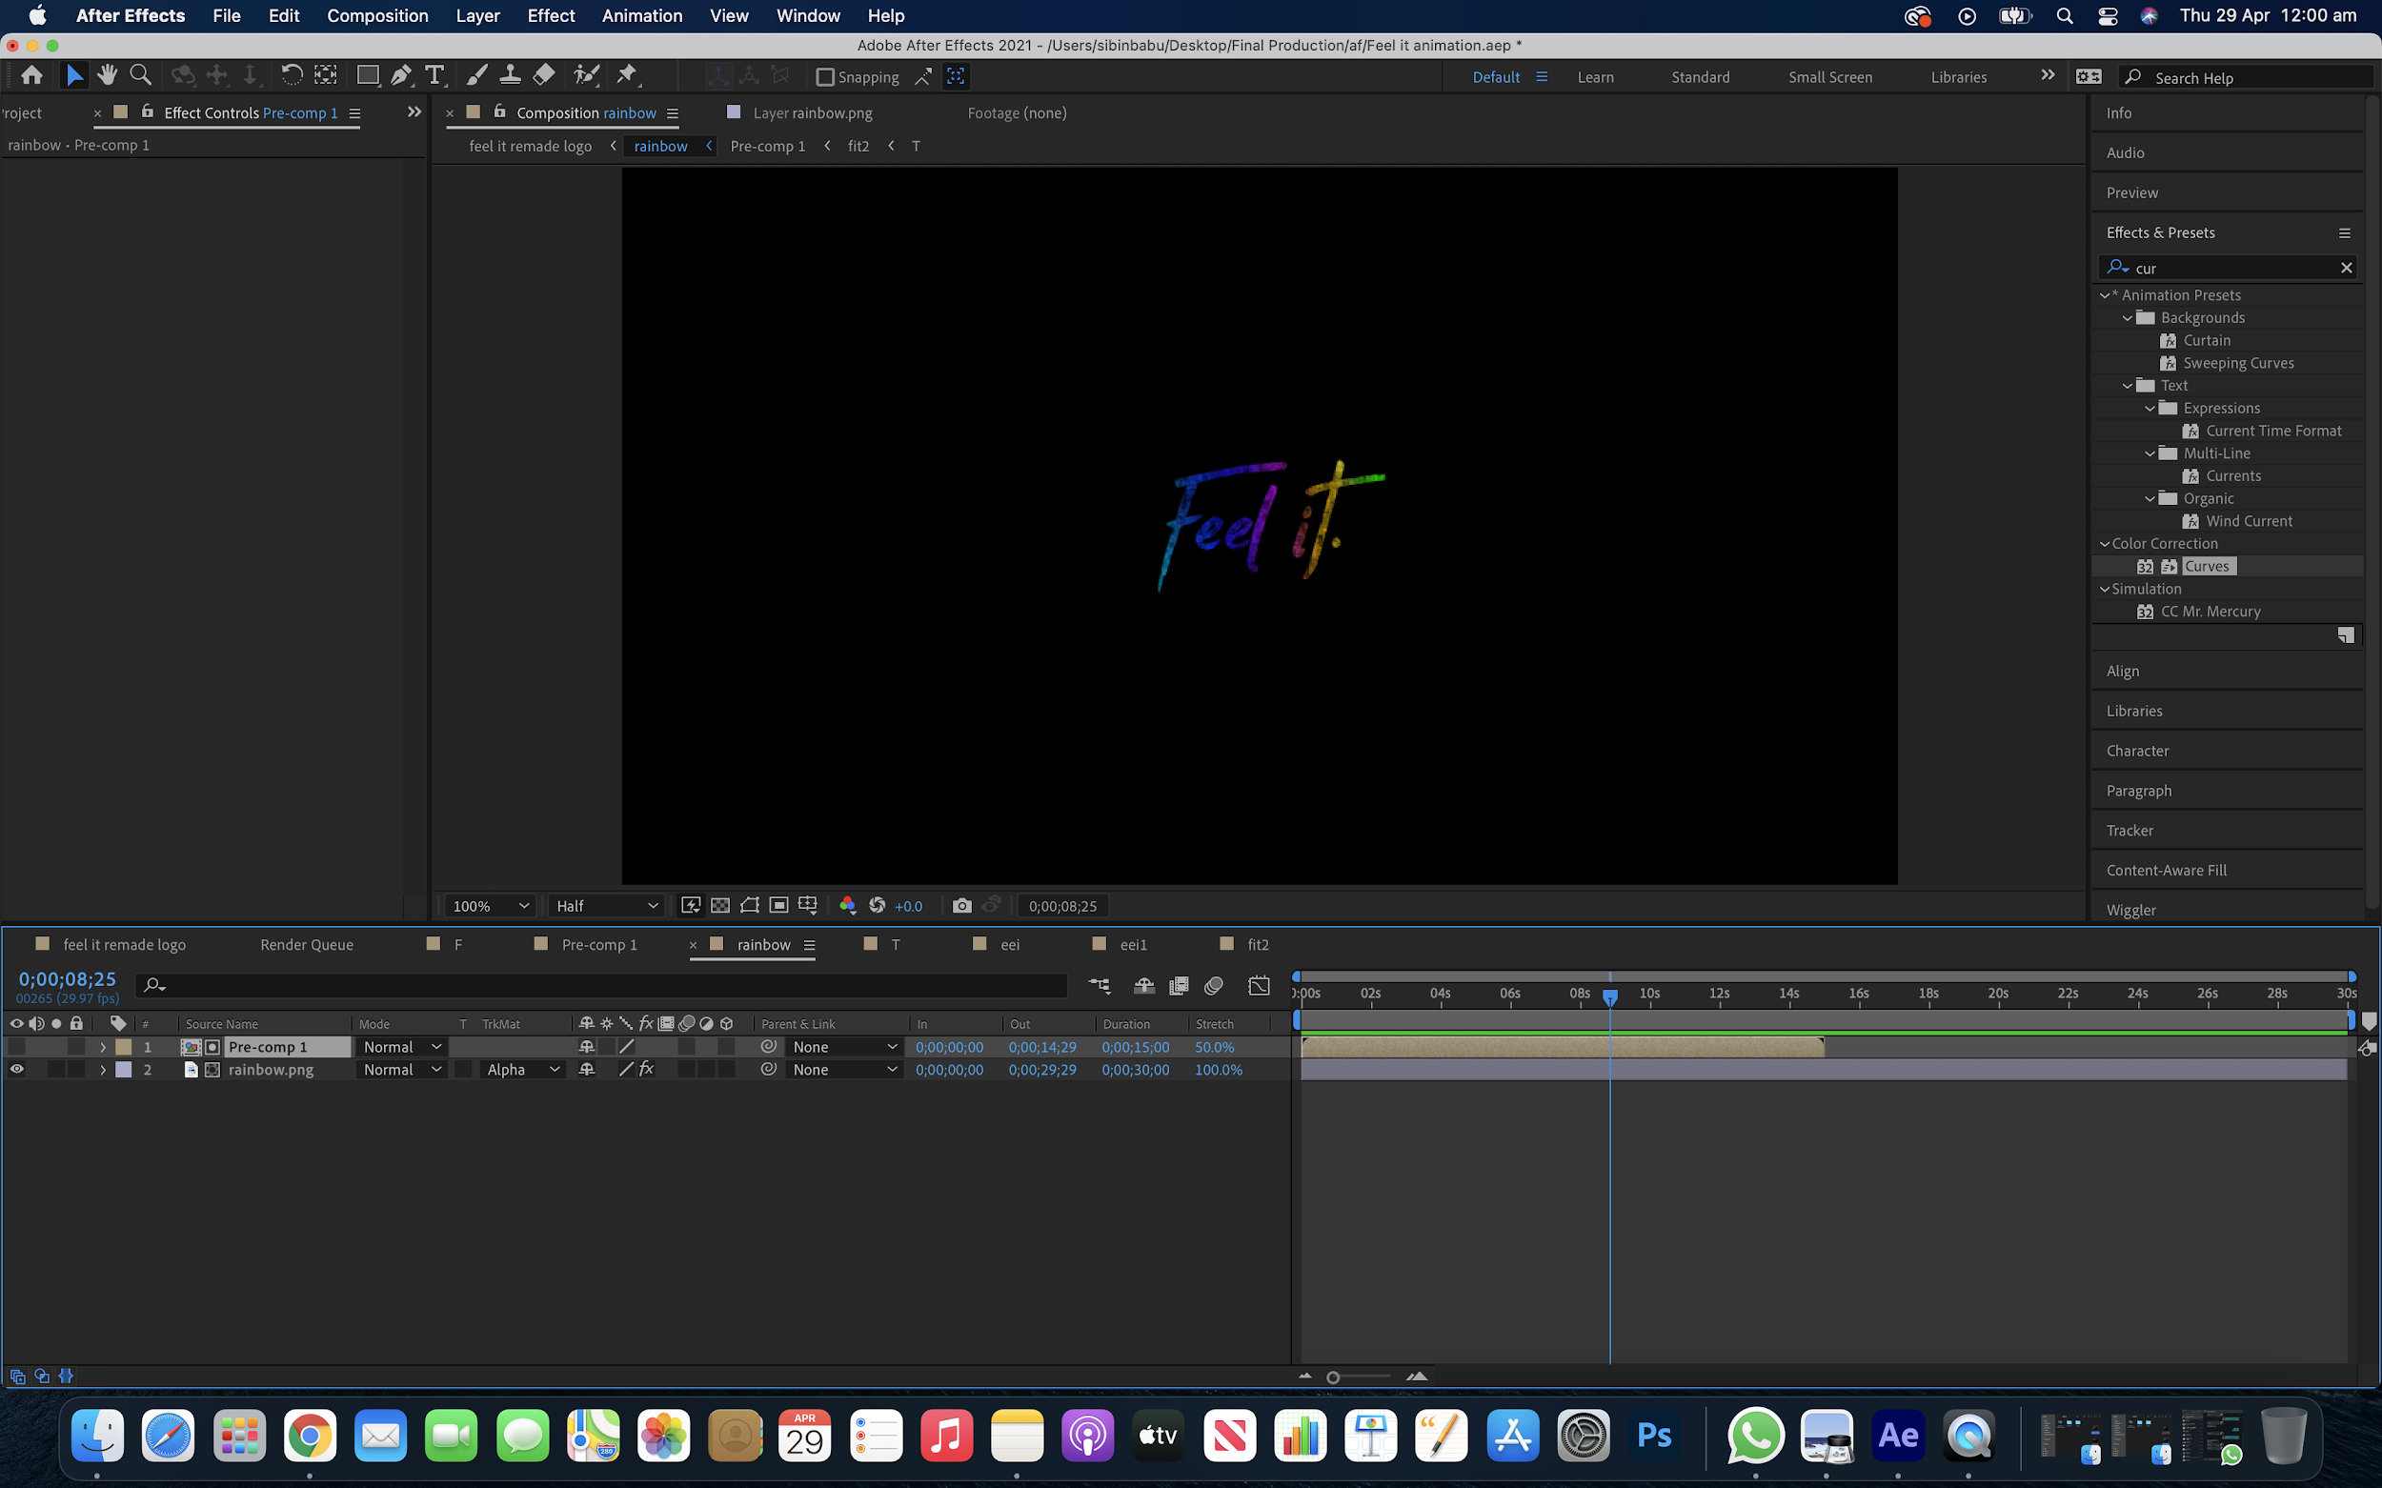
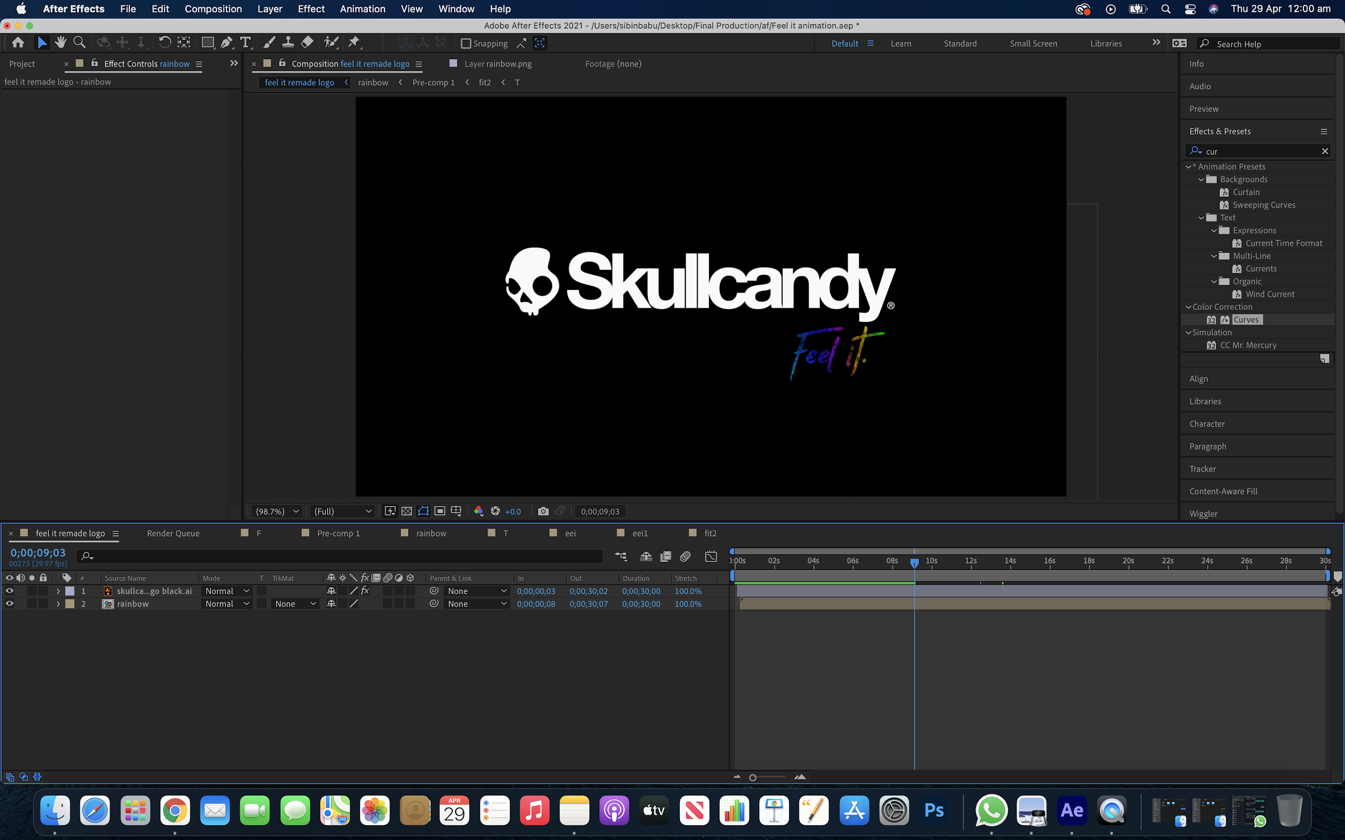
LOGO ANIMATION

Slide 23
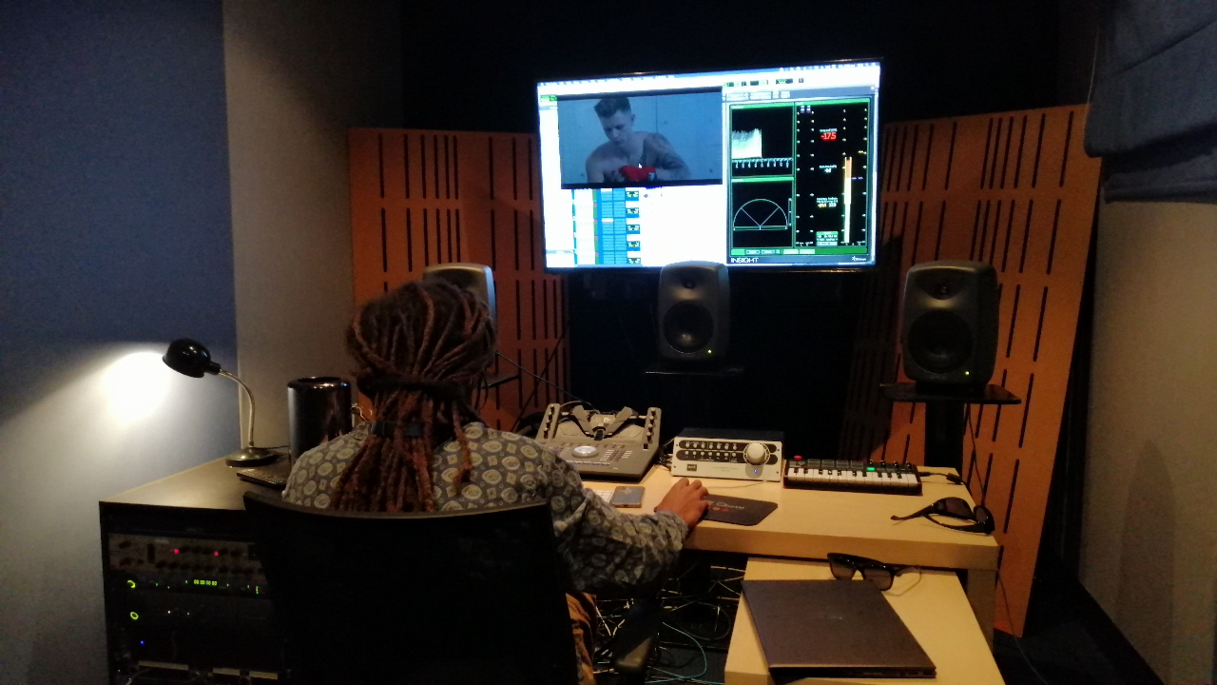
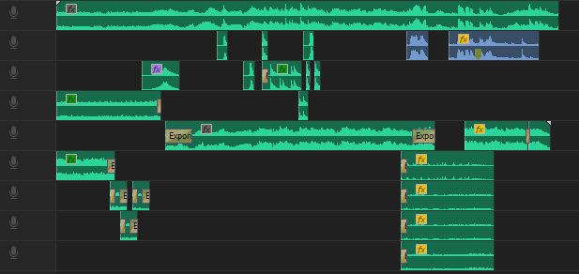
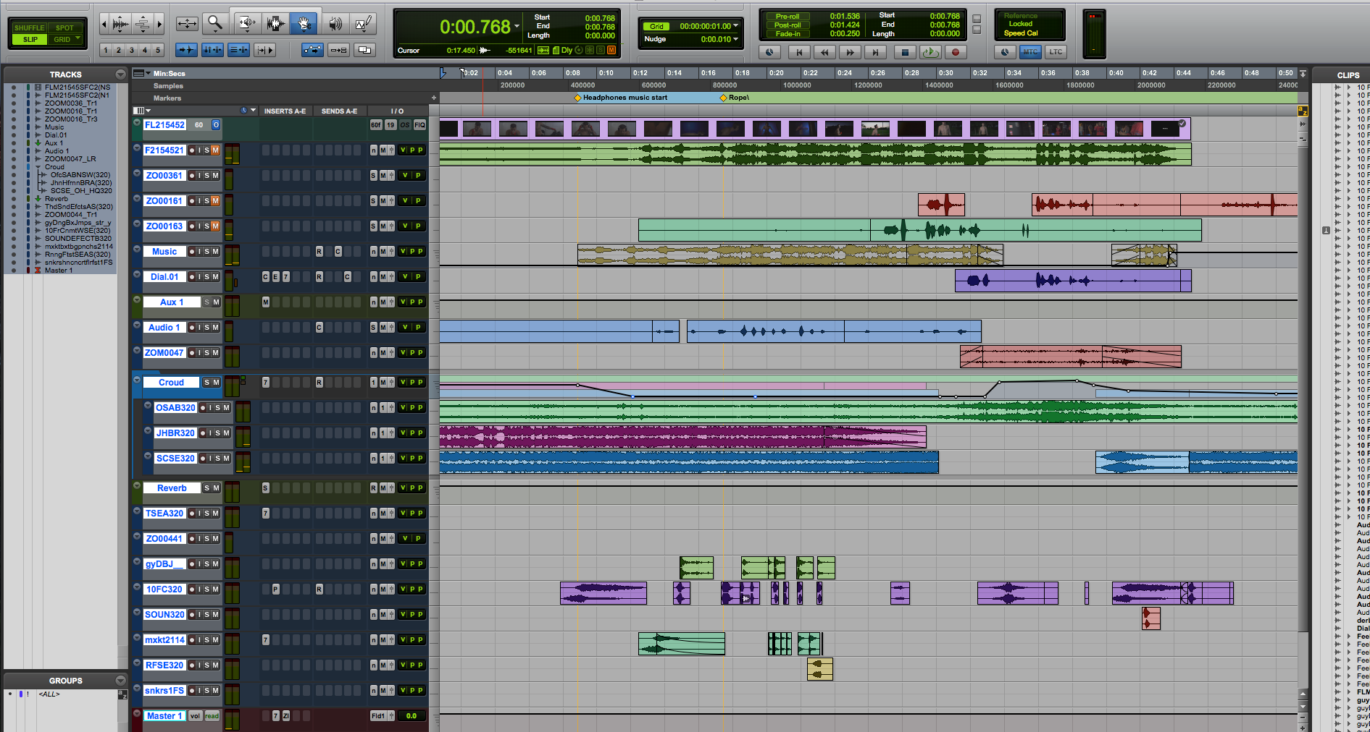
SOUND DESIGN
MY SOUND DESIGN
NARIN’S SOUND DESIGN

Slide 24
45 SECOND TVC

Slide 25
15 SECOND TVC

Slide 26
Written, Directed & Edited by
Riley Arndt and Sibin Babu
Starring: Kristian Webb and Lucie Manzano
Assistant Director: Toby Smyth
On-set Recording and Sound Design: Narin Gayle
Art Direction: Jarrah Wells and Sadie Archibald
Behind The Scenes: Oscar Rockr
Grip: Damien Mcewan
Extras: Kathy, Lachlan, Max, JT, Ellie, Courtney, Harry Sharman, Harry Asbury
Sincere Thanks to Laurie Adalian, Russell Burton, Justin and Bridgette

